Slide 1
ALEVEL COMPONENT 1 PERSONAL INVESTIGATION ART & DESIGN

Slide 2
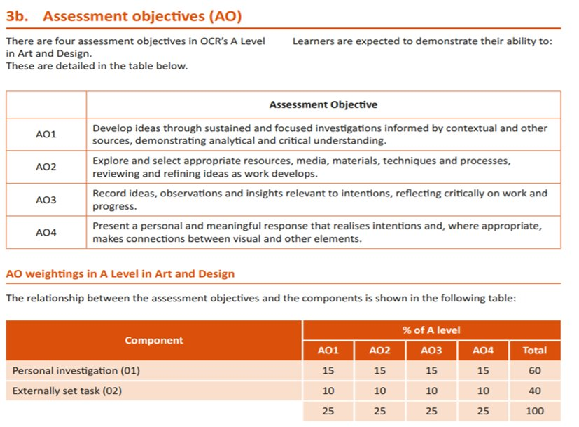
Alevel Art and Design Framework

Slide 3
Assessment Criteria
 | Assessment Objective
AO1 | Develop ideas through investigations, demonstrating critical understanding of sources.
AO2 | Refine work by exploring ideas, selecting and experimenting with appropriate media, materials, techniques and processes
AO3 | Record ideas, observations and insights relevant to intentions as work progresses
AO4 | Present a personal and meaningful response that realises intentions and demonstrates understanding of visual language

Slide 4
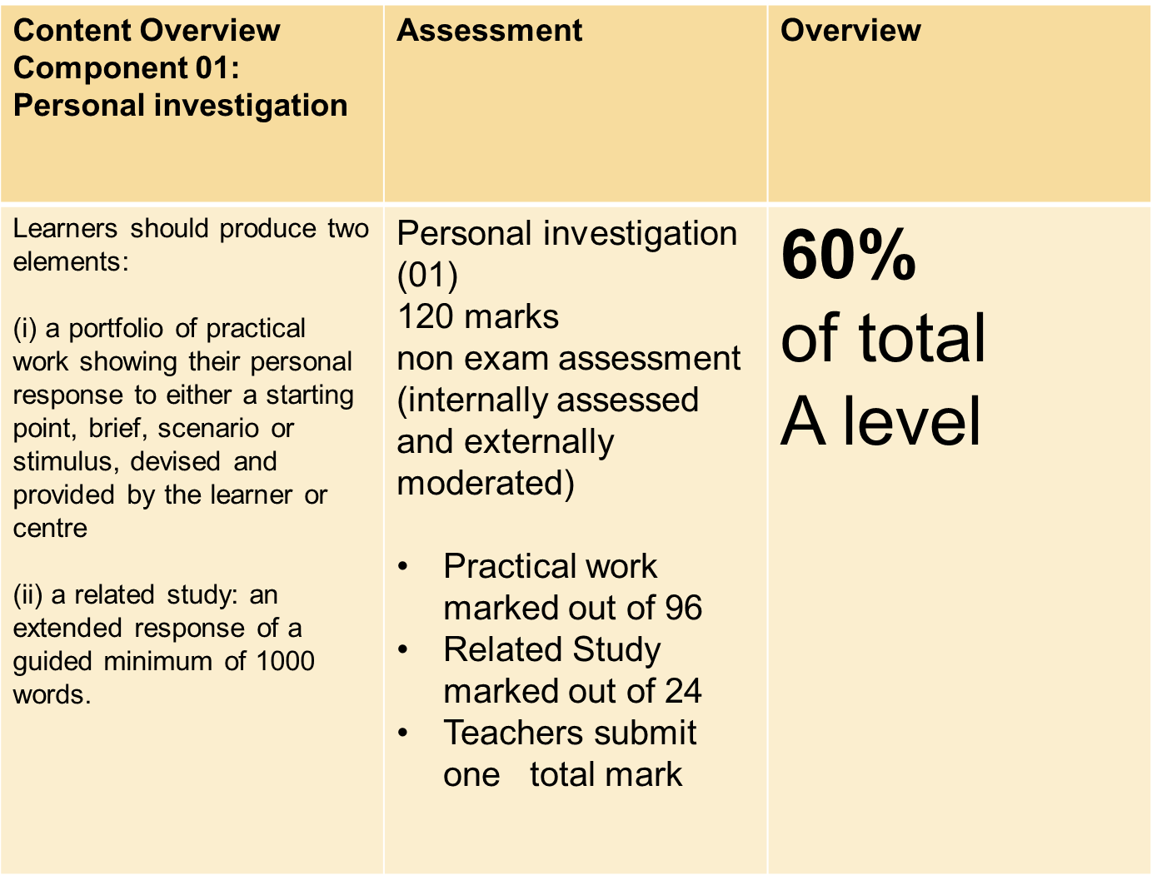
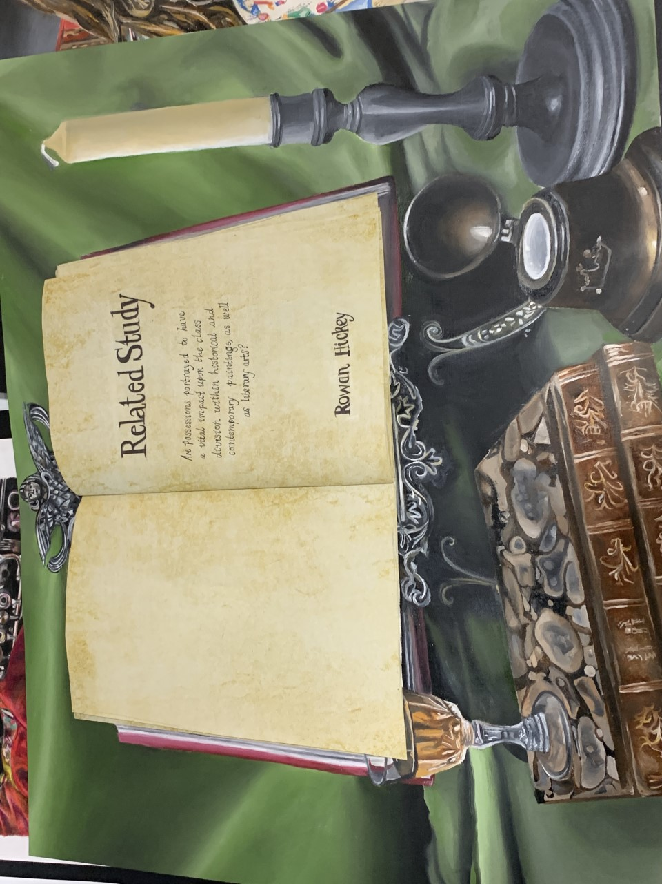
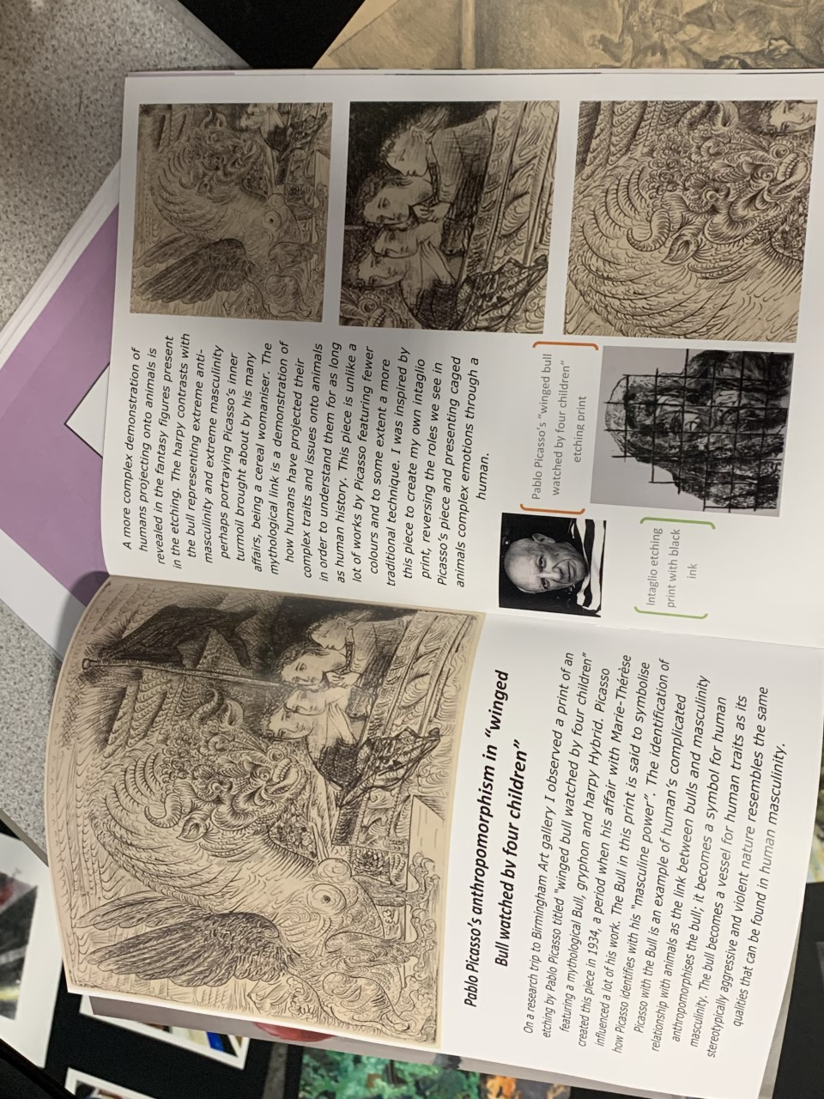
Component 1
Personal Investigation
AO1: Develop:
Research Artists: Create a power point or word/publisher document. Copies of examples of artists Still Life work. Information on/about the artist. Your opinions /thoughts about the work. See next slide –writing frame.
AO1: Own Photos: You should have access to these – saved on your PPT. Select your best photos-reflecting your theme and in focus. Print a colour and black and white copy. Present on boards.
AO3: Record:
Copies from own photos. Detailed pencil studies and colour studies from own photos. Always work on good quality paper. Use the simple grid method if you do not have access to a light box.
Simple grid method:
Divide the artists still life work you want to copy into 4 equal parts. Recreate the still life work one section at a time.
AO1: Develop: Research own artist reference(s).
Google / research your own artist(s). Create a power point or word /publisher documents. Copies of examples of artists work. Information on/about the artist. Your opinions /thoughts about the work. See next slide writing frame.
AO1: Key words:
Tone – shades. Light and dark.
Colour – primary/ secondary/ tertiary/ complementary
Shape – outline. 2D/3D.
Pattern – repeat. Motif.
Line – shape, outline, texture, tone, movement.
Texture – how something actually feels, or visually feels.
Form – 3D shape. Shading to show form.
Develop – move work along. Taking inspiration.
Refine – improve work, act on targets. Fine detail.
Record – photograph, observe, draw, paint.
Select – work with strength, appropriate media, imagery.
Related Study (24 marks)
AO1 | AO2 | AO3 | AO4 | RS
24 | 24 | 24 | 24 | 24

