Slide 1
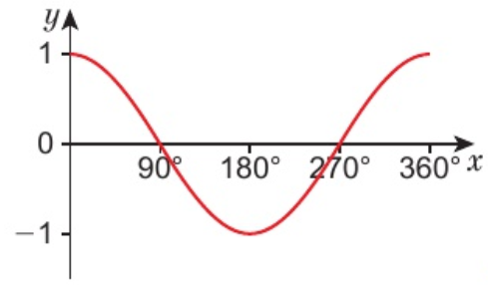
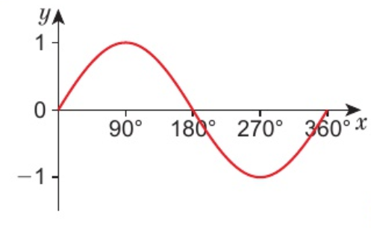
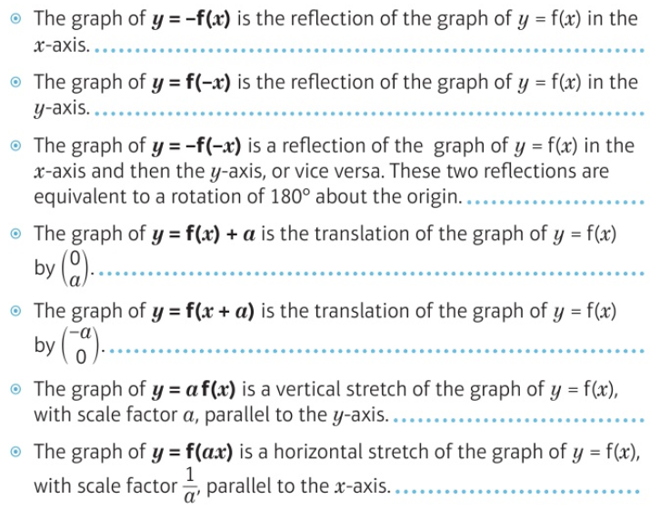
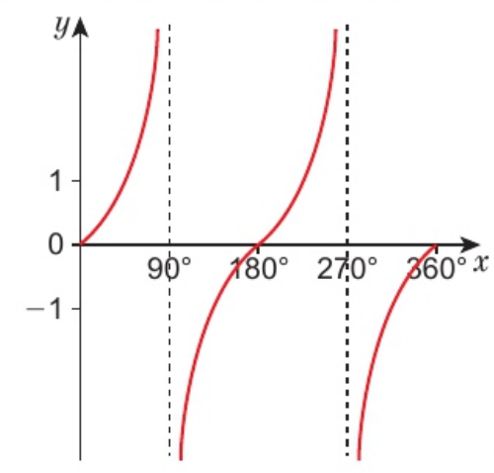
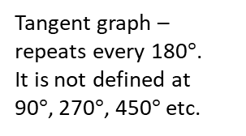
Maths Knowledge Organiser – Trigonometric graphs
I can understand how to find the sine, cosine or tangent of any angle.
I can use the sine, cosine and tangent graphs to solve equations.
I can recognise how changes in a function affect trigonometric graphs.
Keywords
Sine, cosine, tangent, graph, reflection, translation, stretch, vertical, horizontal.
Solving trigonometric equations
Trigonometric equations can have more than one solution. Use your calculator to find the first one:
E.g. 5sinx = 3 → $x= \sin^{−1}{(3÷5)}$ → $x=36.9°$
Cosine graph - repeats every 360$°$
BB
Trigonometric graphs
Sine graph - repeats every 360$°$
Transforming trigonometric graphs
Tangent graph – repeats every 180$°$.
It is not defined at 90$°$, 270$°$, 450$°$ etc.
Prior Knowledge: Trigonometry, sine and cosine rule, transforming graphs, solving equations
Corbett Maths Clip:
324, 328 - 330
Hegarty Clip:
303-305

