Slide 1
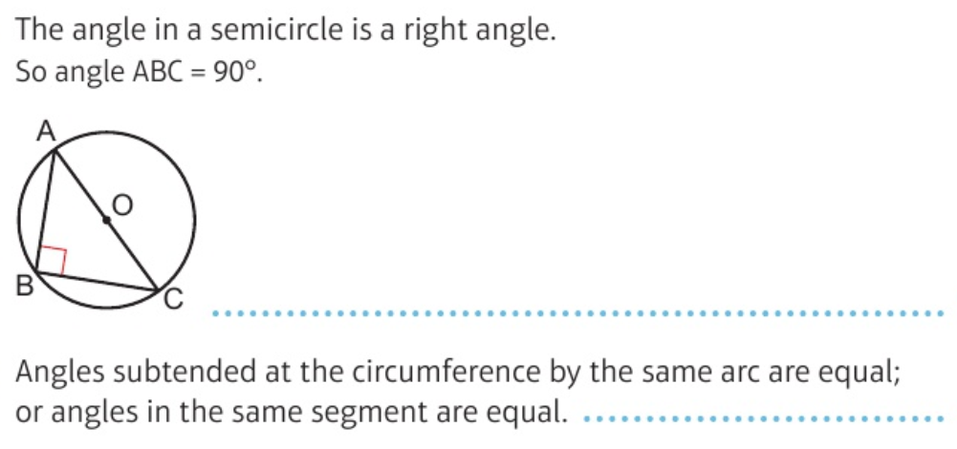
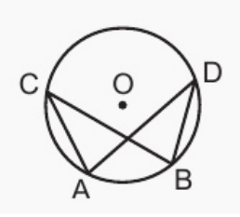
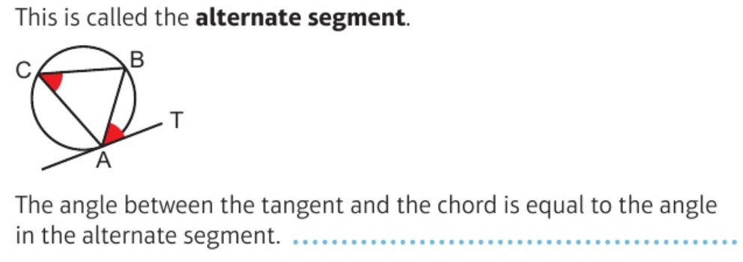
Maths Knowledge Organiser – Circle theorems
I can solve angle problems using circle theorems.
I can give reasons for angle sizes using mathematical language.
I can use logical reasoning to solve circle theorem problems.
Keywords
Tangent, radius, chord, subtended, semicircle, arc, circumference, cyclic quadrilateral, alternate segment.
Prior Knowledge: parts of a circle, angle facts
Corbett Maths Clip: 64, 65
Hegarty Clip: 597-606

