Slide 1
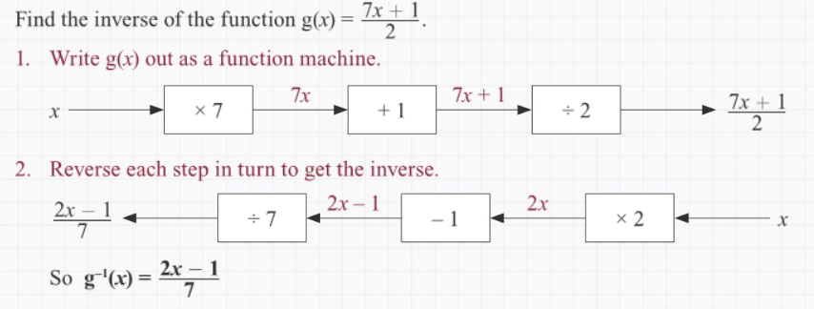
Maths Knowledge Organiser - functions
I can use function notation.
I can find composite functions.
I can find inverse functions.
Key words: Function, composite, inverse, notation
A function is a rule for working out values of y given values of x. The notation f(x) is read as “f of x”, where f is the function.
Substitution
BB
Composite functions
If f(x) and g(x) are two functions, then gf(x) is a composite function.
For example, gf(x) means “put x into function f, then put the answer into function g”.
Inverse functions (reverses the effect – f ⁻¹(x))
BB
Prior knowledge: Substitution, rearranging formulae
Corbett Maths Clip: 369, 370
Hegarty Clip: 290-296

