Slide 1
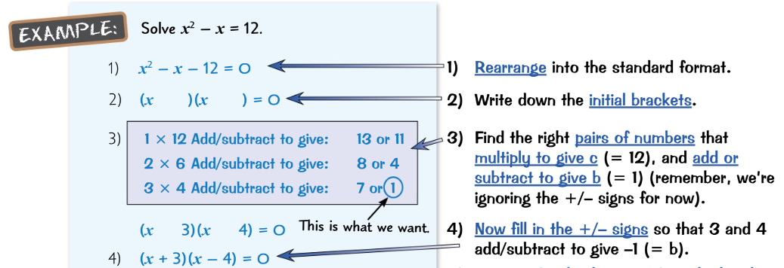
Maths Knowledge Organiser
Expanding and factorising
I can understand and use algebraic vocabulary and notation.
I can simplify algebraic expressions.
I can write expressions and find their values.
I can expand brackets and factorise expressions completely.
I can substitute values into formulae.
Keywords
term, like terms, variable, constant, coefficient, simplify, Highest Common Factor (HCF), Formula(e)
Factorising: One bracket
Two brackets
Expanding: One bracket
Two brackets
Three brackets
= $\left(x^{2}+5x+6\right)\left(2x−1\right)$
= $x^{3}−x^{2}+10x^{2}−5x+12x−6$
= $x^{3}+9x^{2}+7x−6$
Prior Knowledge
Calculate with negative numbers, find HCF, simplifying expressions
Corbett Maths Clip
Hegarty Clip
160 to 166
9, 13, 16, 18, 19, 20

