Slide 1

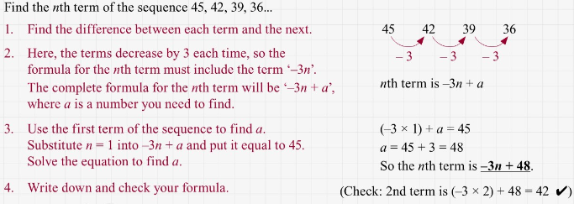
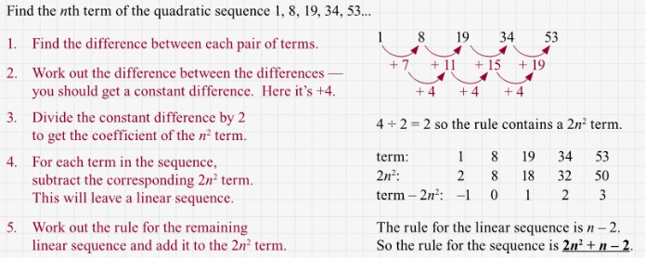
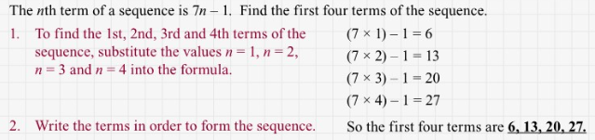
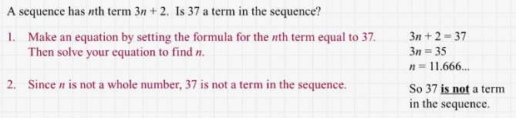
Maths Knowledge Organiser
Linear and quadratic sequences
To find a general formula for the nth term of an arithmetic sequence.
To determine whether a number is part of an arithmetic sequence.
To find the nth term of a quadratic sequence.
To solve problems using geometric sequences.
Linear, quadratic, sequence, geometric, Fibonacci, arithmetic, constant multiplier, common difference.
Linear sequences
BB
Quadratic sequences
Prior knowledge:
Numerical and algebraic fluency.
Hegarty Clips:
196-198, 248-250, 263-264, 919-922
Corbett Maths Clip
288 and 289

