Slide 1
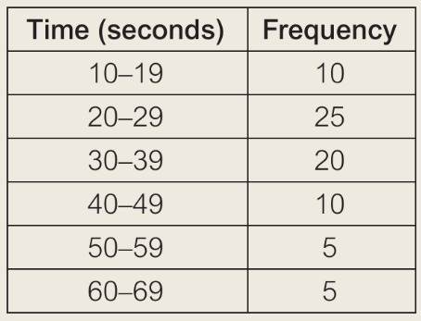
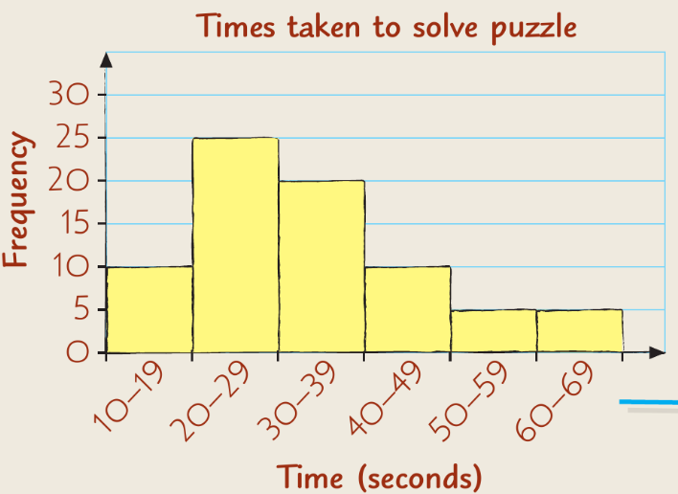
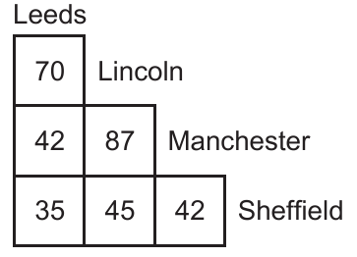
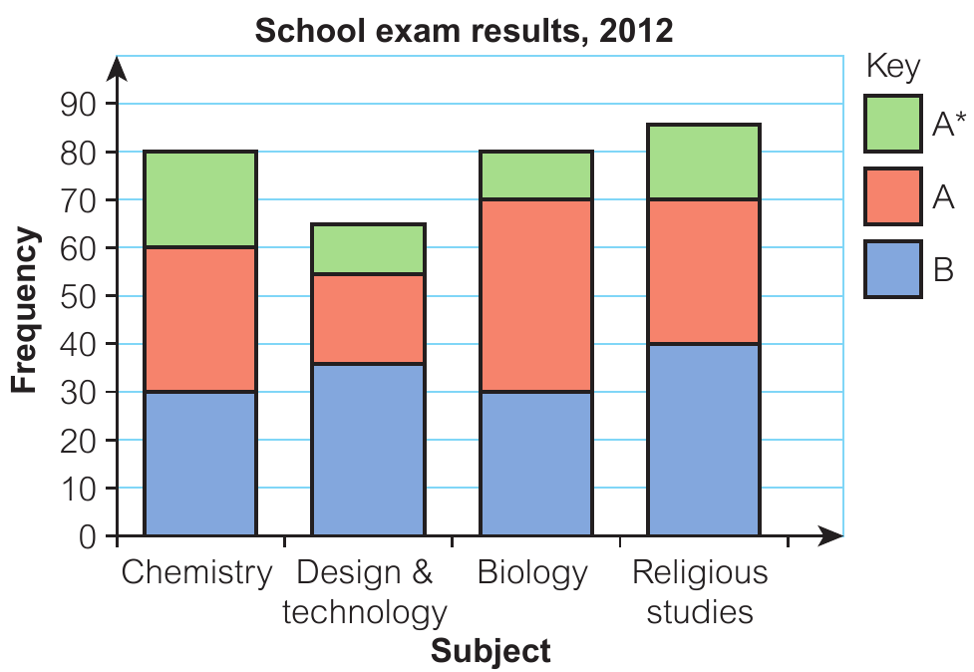
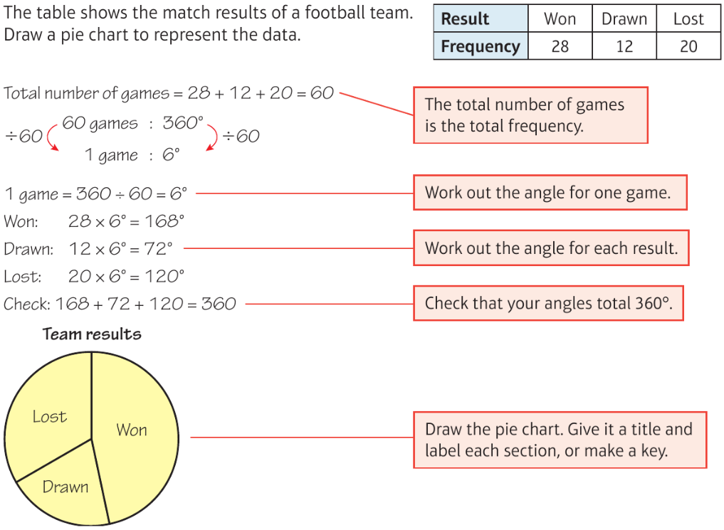
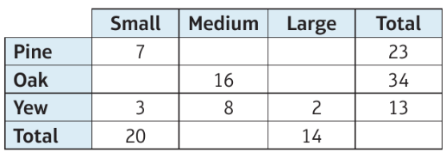
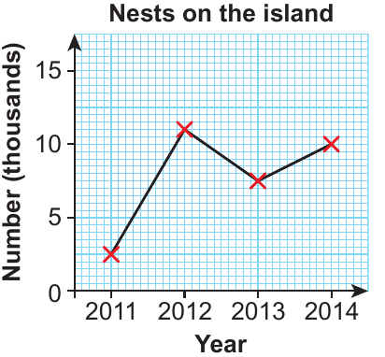
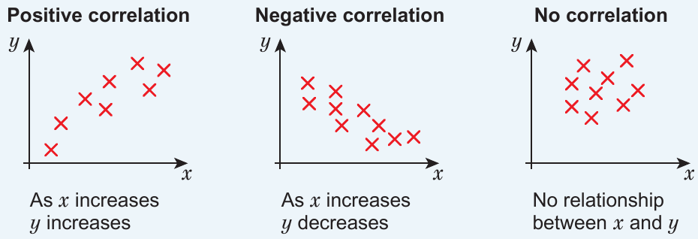
Maths Knowledge Organiser
Analysing and displaying data
I can complete and read information from tables and distance charts.
I can draw pie charts and read information from them.
I can draw and interpret data from bar charts and stem and leaf.
I can draw and interpret time series graphs and scatter diagrams draw a line of best fit.
I can design data collection sheets and two-way tables and use them to solve problems.
Keywords
Data, value, range,
mode, modal, median, pictogram,
key, bar chart, bar-line chart, tally chart, frequency, frequency table, groups, classes, grouped tally chart, modal class, grouped frequency
table, compare, line graph, dual bar chart, compound bar chart
Displaying discrete data
Displaying continuous data
Displaying distance and times
BB
No gaps
Distance chart
Train timetable
Composite bar chart
KEY
Frequency table Frequency diagram
Modal class is the class with the highest frequency
Range is the highest time – lowest time
Pie chart
Height of plants
Two way table
Stem and leaf
Time series
Scatter graphs
With
Line-of-best-fit
Prior Knowledge
Averages, drawing axes, labelling axes, tallying, pencil and ruler skills
Corbett Maths Clip
Hegarty Clip
50, 53, 56, 57, 147, 128, 155, 156, 160, 162, 318, 320, 321
401-403, 431, 453, 377

