Slide 1
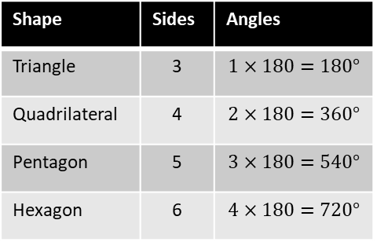
Maths Knowledge Organiser
Angle facts
I can …
Solve problems using quadrilateral properties. | Identify congruent shapes.
Calculate missing angles on parallel lines. | Solve angle problems in triangles.
Calculate interior and exterior angles of polygons. | Explain why some shapes tessellate.
Solve angle problems using equations.
Keywords
Congruent, Similar, Bisect, Diagonal, Vertex, Vertices, Edge, Face, Opposite, Parallel, Perpendicular, Alternate, |Corresponding, Co-Interior, Equilateral, Isosceles, Scalene, Interior, Exterior, Sum, Regular, Polygon, Irregular, Tessellate.
A
L
Angle Facts
Congruent – (Identical)
A shape is congruent if they are identical.
Similar
Two shapes are similar if one is an enlargement of the other (angles will be the same, sides will not)
180º
CorrEsponding
180º
Co-interior
=180º
90º
AlterNate
360º
Perpendicular
BB
Interior Angles
Exterior Angles
(Number of sides – 2)$×180°$
Exterior = 180 – Interior
Tessellation
Where shapes fit together without a gap.
Exterior
Regular Exterior Angle
Interior
360º
Number of sides
$\frac{360}{interior}$ has to be an integer for the shape to tessellate.
Prior Knowledge
Basic Angle Facts, Properties of 2d shapes
Corbett Maths Clip
2, 66, 67, 25, 36, 32, 36
Hegarty Clips
812-814, 485-487, 477-478, 481-483, 560-564

