Slide 1

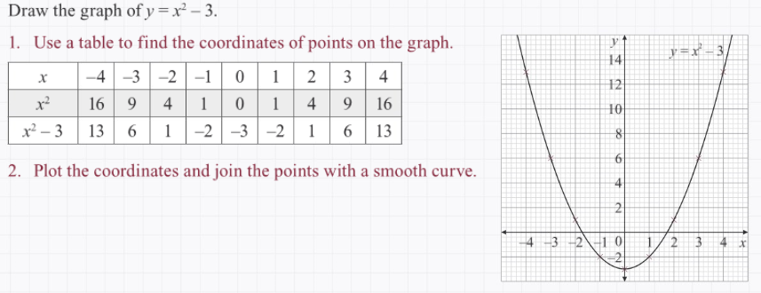
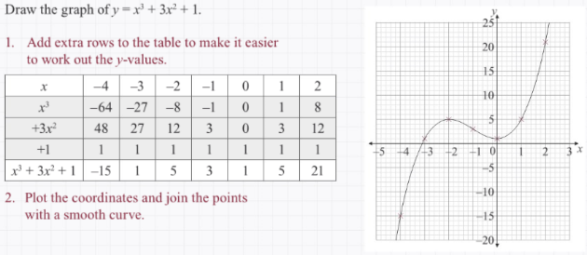
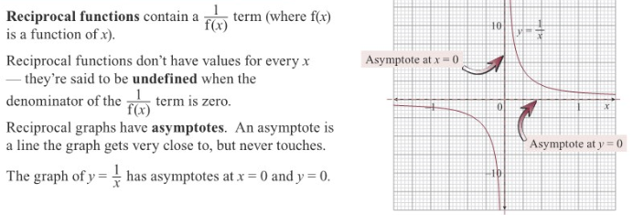
Maths Knowledge Organiser
Quadratic, Cubic and Reciprocal graphs
Draw quadratic graphs.
Draw cubic graphs.
Draw graphs of reciprocal functions.
Recognise graphs from its shape.
Keywords: parabola,
Minimum, maximum,
Quadratic, reciprocal,
Cubic, gradient, and
symptotes.
BB
Quadratic graphs
Cubic graphs
Reciprocal graphs
Prior knowledge – linear graphs, real life graphs, line segments, gradient and proportion.
Corbett Maths Clip
264, 344, 346
Mathswatch Clip
251, 298, 299

