Slide 1
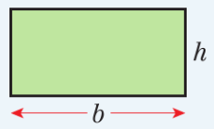
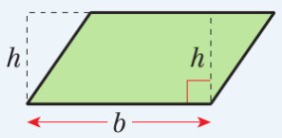
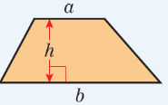
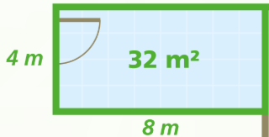
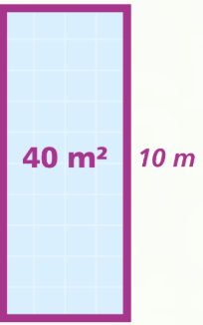
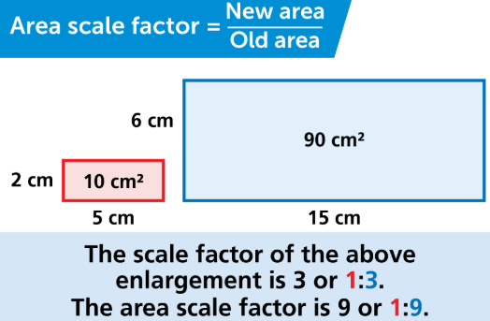
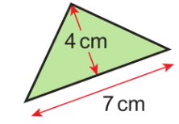
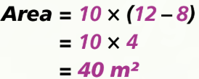
Maths Knowledge Organiser
Unit 7 – Perimeter and area.
I can find the perimeter and area of rectangles, triangles, parallelograms and trapeziums.
I can find the area of compound shapes made from rectangles and triangles.
I can convert between metric units of area volume and capacity.
I can work backwards to find a missing length.
Keywords
Perimeter, area, perpendicular height, trapezium, isosceles, compound shape.
Perimeter is the distance around the outside of a shape. Area measures the space inside a 2D shape.
Converting between units
Area of a rectangle Area parallelogram
Prior Knowledge
Perimeter, area, units of length, area and volume, 2D shapes and 3D shapes
Corbett Maths Clip
Hegarty Clips
41,44,45,48,49,309,310,355,356
539-543, 545, 536-537, 548-552, 546, 547

