Slide 1

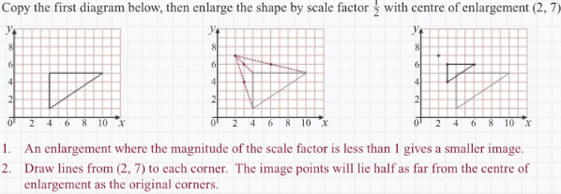
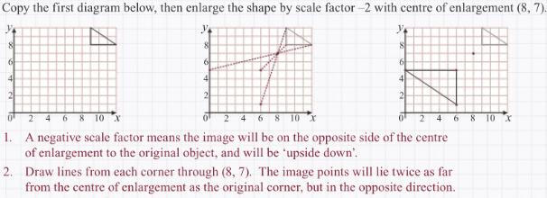
Maths Knowledge Organiser
Negative and fractional enlargement
To enlarge a shape by a negative scale factor from a given centre of enlargement.
To enlarge a shape by a fractional scale factor from a given centre of enlargement.
Negative enlargement
BB
Keywords – scale factor, enlarge, object, negative, fraction and centre.
P
Prior knowledge Multiplying fractions and negative numbers, translation and enlargement by positive integers.
Fractional enlargement
Corbett Maths Clip
Hegarty Clip
107
108
642-647

