Slide 1
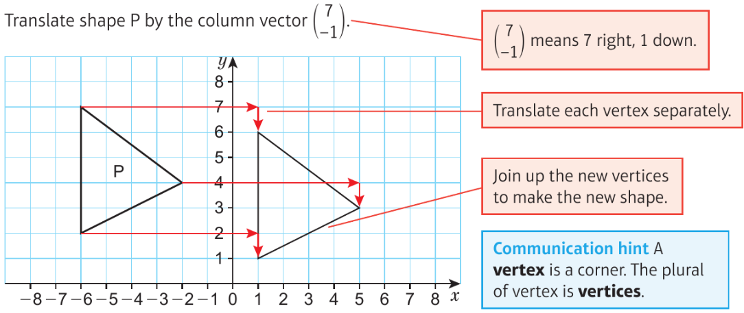
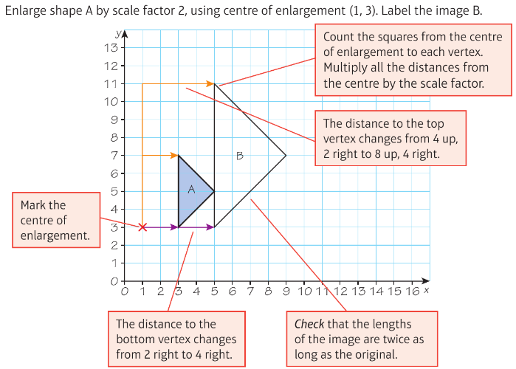
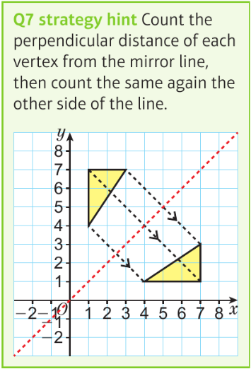
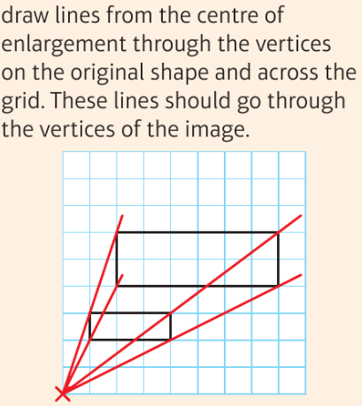
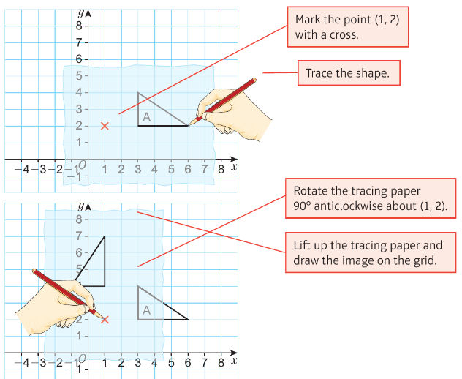
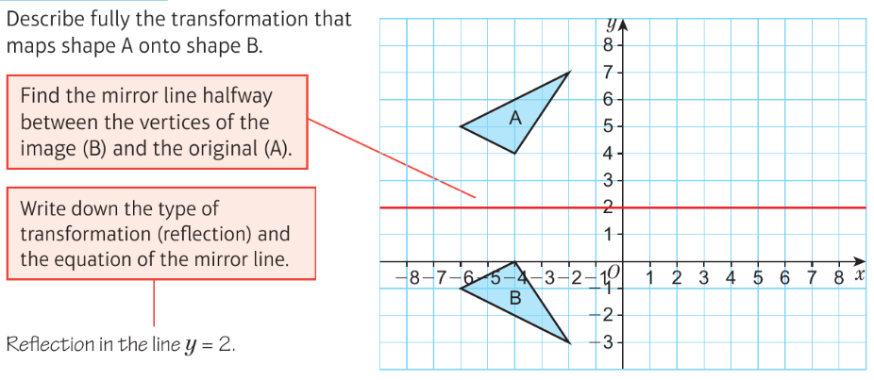
WBS Maths Knowledge Organiser
Unit 10 - transformations
I can translate a shape on a co-ordinate grid, using vectors.
I can reflect a shape on a co-ordinate grid.
I can rotate a shape on a co-ordinate grid.
I can enlarge a shape by a scale factor using a centre of enlargement.
I can describe transformations.
Keywords
column vector, vertex, vertices, transformation, image, maps, mirror line, centre of rotation, scale factor,, centre of enlargement, origin
Averages and range
Estimated and range from a frequency table
Translation
Enlargement
Reflection
BB
BB
Rotation
Describing transformations
Enlargement
1)Type of transformation
2)Scale factor
3)Centre of enlargement
1)Type of transformation
2)Centre of rotation
3)Direction and degrees
1)Type of transformation
2) Line of reflection
1)Type of transformation
2)vector
Prior Knowledge
four types of transformations, to understand ‘left’ and ‘right’. perpendicular, degrees in fractions of a turn, scale factor.
Corbett Maths Clip
Hegarty maths
104 105 106 272 273 274 275 316 323 325 326 353
637-656, 828

