Slide 1
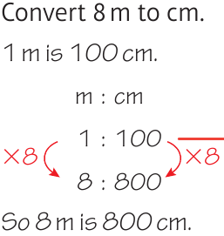
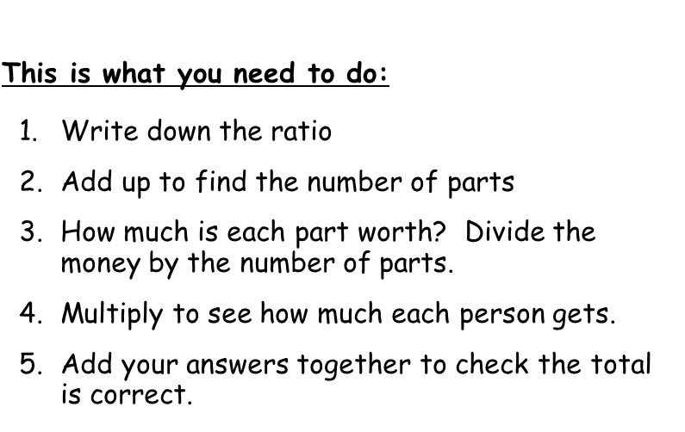
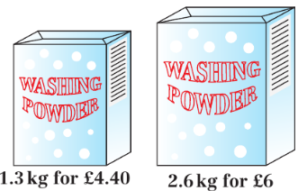
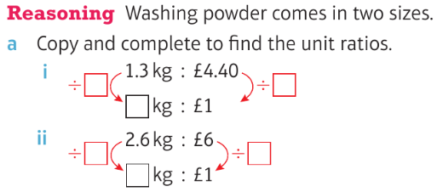
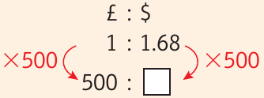
WBS Maths Knowledge Organiser
Unit 11a - ratio
I can write ratios in their simplest form, or in the form n:1 or 1:n.
I can solve problems using ratios.
I can use ratio to convert between units.
I can use the unitary method solve proportion problems.
I can work out best value for money.
Keywords
Ratio, simplify, equivalent, highest common factor, simplest form, unit ratio, proportion, unitary method, direct proportion, inverse proportion
Averages and range
Estimated and range from a frequency table
Simplifying ratios
Converting between units
BB
BB
Unitary method
unit ratios
This method is used to find one of something.
From this we can find any amount we want...
4
3
4
6.2
I walk 4 miles in 48 minutes. How long would it take to walk 3 miles It would take me 48 ÷ 4 = 12 minutes to walk 1 mile. So it would take 3 x 12 = 36 mins to walk 3 miles b) 7 miles I mile takes 12 minutes So it would take 7 x 12 = 84 mins to walk 7 miles
2
2
4
5
3
12.5
Sharing in a given ratio
3:2
3+2 = 5 parts
5parts = £20
1 part = 20÷5 = £4
2 x 4 = £8
3 x 4 = £12
Isabel £8:Freya £12
Currency conversion
Best buy
0.29545kg/£1
4.4
4.4
6
6
840
0.43333kg/£1
£8 : £12
2.6kg box is best buy
Prior Knowledge
Multiply and divide whole numbers, know and use metric conversions, use index notation, understand and use place value to order decimals, understand and use y = mx + c.
Corbett Maths Clip
Hegarty maths
254, 255, 256, 269, 270, 271
329-342

