Slide 1
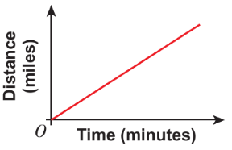
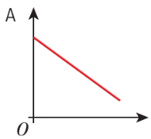
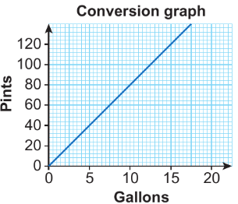
WBS Maths Knowledge Organiser
Unit 11b - proportion
I can recognise direct proportion on a graph.
I can understand the link between the unit ratio and the gradient.
I can solve problems involving direct proportion.
I can recognise inverse proportion on a graph.
I can solve problems involving inverse proportion.
Keywords
Ratio, simplify, equivalent, highest common factor, simplest form, unit ratio, proportion, unitary method, direct proportion, inverse proportion
Averages and range
Estimated and range from a frequency table
Direct proportion
BB
Inverse proportion
Direct proportion graph
Inverse proportion graph
Unit ratio and gradient
Gradient (m) = $\frac{change in y}{change in x}$
m = $\frac{80}{10}$ = 8
the gradient is the conversion factor
5 gallons = 40 pints
If 2 workers take 5 hours
1 worker will take 10 hours
80
10
10 ÷ 4 = 2.5 hours
=2hours 30 minutes
10 ÷ 3 = 3.333 hours
=3hours 20 minutes
x 8
the gradient is the conversion factor
Prior Knowledge
Multiply and divide whole numbers, know and use metric conversions, use index notation, understand and use place value to order decimals, understand and use y = mx + c.
Corbett Maths Clip
Hegarty maths
254, 255, 256, 269, 270, 271
339-342

