Slide 1

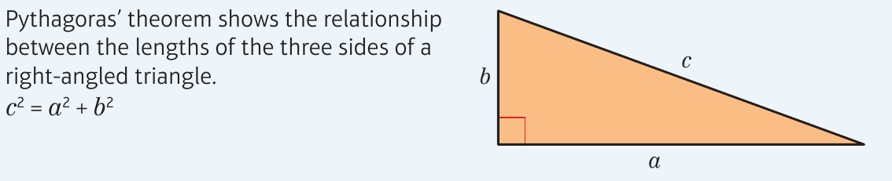
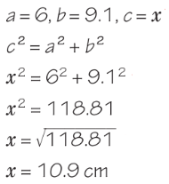
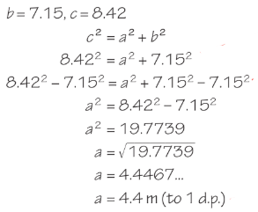
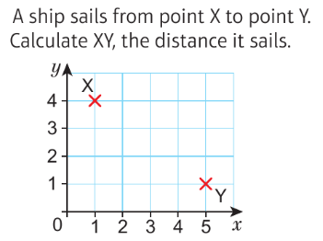
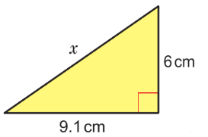
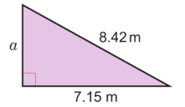
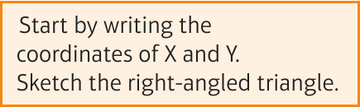
WBS Maths Knowledge Organiser
Unit 12a Right angled triangles and Pythagoras theorem
I can find the length of the hypotenuse in a right-angled triangle
I can find the length of a shorter side in a right-angled triangle
I can find the length of a line segment
Keywords
Right-angle, hypotenuse, square number, square root, inverse
Finding the hypotenuse
Finding a shorter side
Finding line segment
Prior Knowledge
Calculate squares and square roots, substitute into expressions, understand the meaning of ≠
Corbett Maths Clip
Hegarty maths
257, 258, 260, 261
497-504

