Slide 1
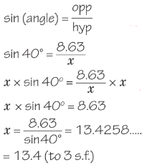
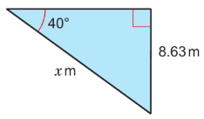
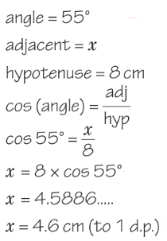
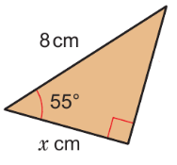
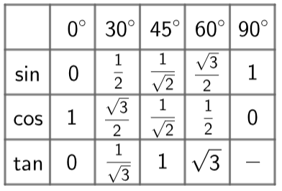
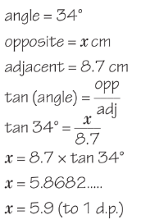
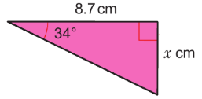
WBS Maths Knowledge Organiser
Unit 12b – right angled triangles and trigonometry
I can label any SAS triangle with opposite, adjacent, hypotenuse.
I can use the sine rule to find a missing side or angle in a right-angled triangle
I can use the cosine rule to find a missing side or angle in a right-angled triangle
I can use the tangent rule to find a missing side or angle in a right-angled triangle
Recall formulae for the sine, cosine and tangent ratios
Keywords
Right-angle, opposite, adjacent, hypotenuse, sine, cosine, tangent, inverse
Sine Rule
Cosine Rule
Tangent Rule
Prior Knowledge
Simplify fractions, convert fractions to decimals, use the sin/cos/tan button on a calculator
Corbett Maths Clip
Hegarty maths
508-514
329-336, 341

