Slide 1


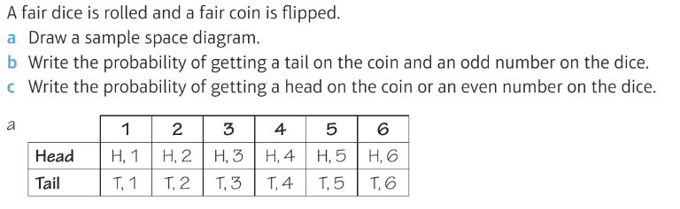
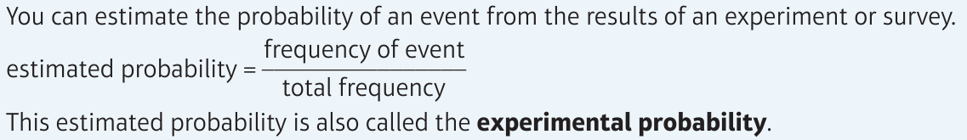
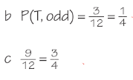
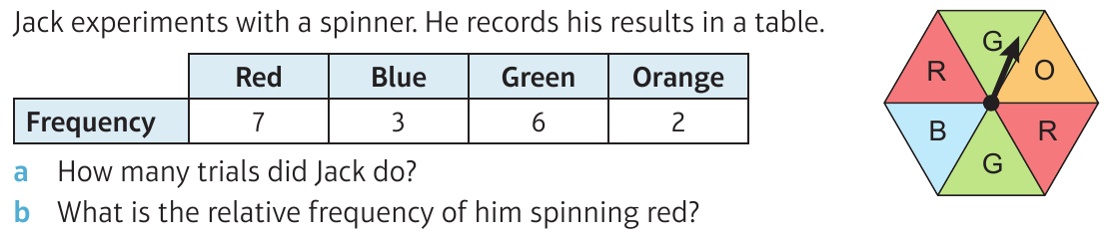
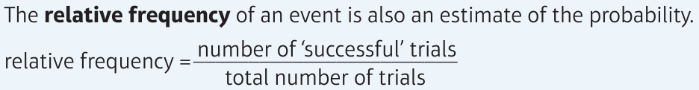
WBS Maths Knowledge Organiser
Unit 13a - probability, simple and experimental
I can calculate simple probabilities from equally likely events and sample space diagrams.
I understand the terms mutually exclusive and exhaustive.
I can find, interpret or predict probabilities from experimental data.
Keywords
Probability, chance, exhaustive, mutually exclusive, experimental, independent
Prior Knowledge
Simplify fractions, add/subtract/multiply fractions, listing outcomes, convert fractions/decimals/percentages, use two way tables.
Corbett Maths Clip
Hegarty maths
244-251, 253
351-353, 386-388, 391

