Slide 1

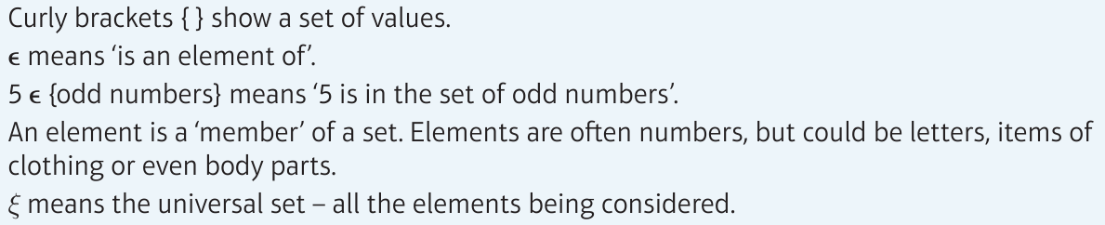
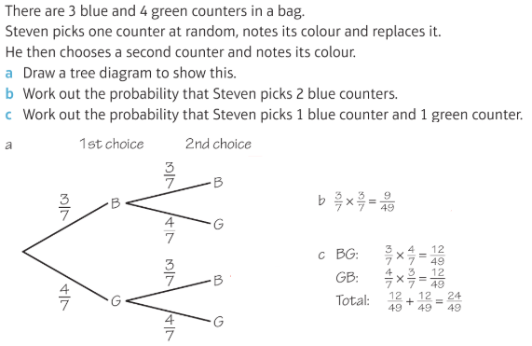
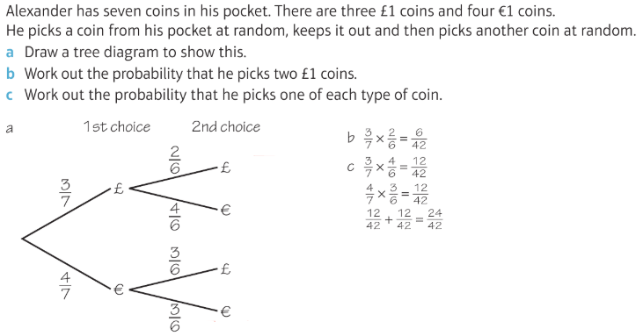
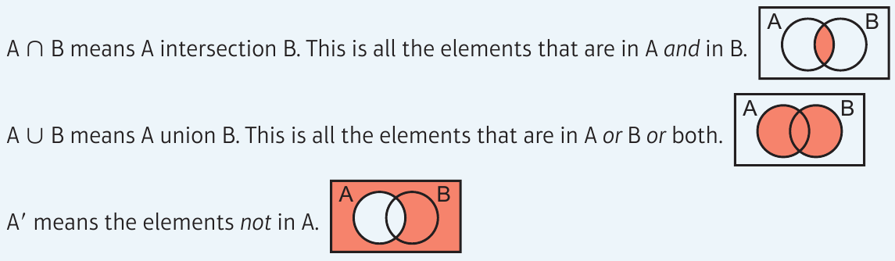
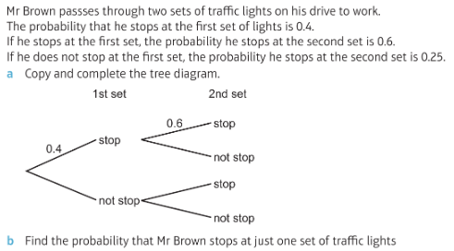
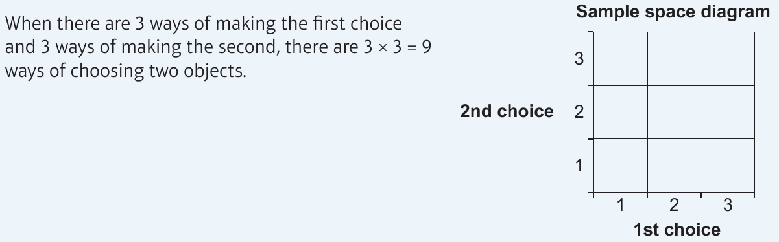
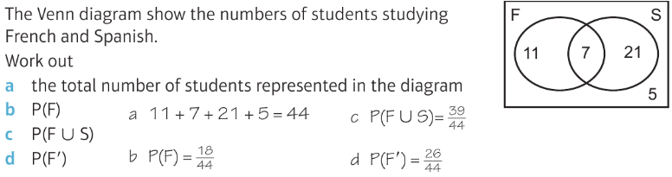
WBS Maths Knowledge Organiser
Unit 13b - Probability Venn and Tree diagrams
I can use and understand Venn diagrams including specific notation.
I can use Tree diagrams and understand the difference between independent and non-independent events.
Keywords
Intersection, union, independent, non-independent, element, Universal Set
Venn Diagrams
Tree Diagrams
Prior Knowledge
Simplify fractions, add/subtract/multiply fractions, listing outcomes, convert fractions/decimals/percentages, use two way tables.
Corbett Maths Clip
Hegarty maths
252, 379, 380
386-388, 423

