Slide 1
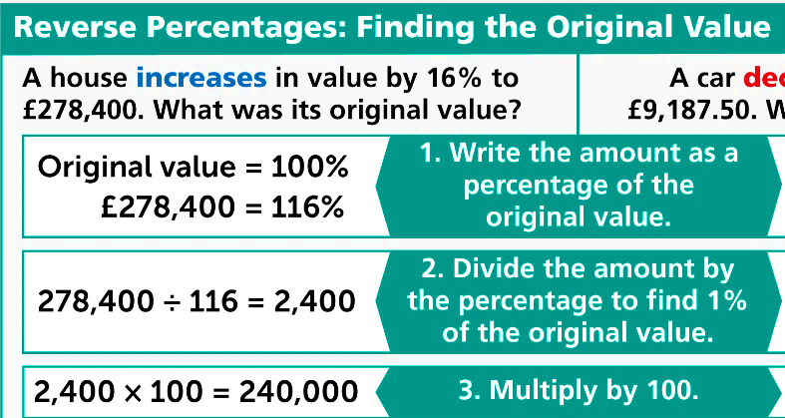
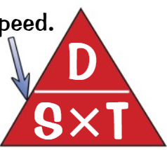
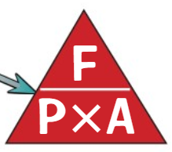
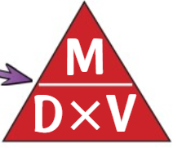
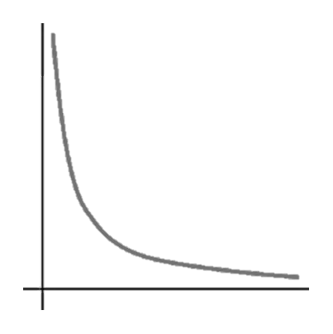
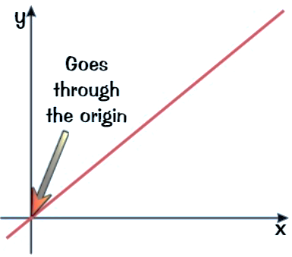
WBS Maths Knowledge Organiser
Unit 14 – Multiplicative reasoning
I can …
Calculate percentage profit | Calculate repeated percentage change.
Express a number as a percentage of another. | Solve problems with compound measures.
I can reverse a percentage change. | Calculate average speed, distance and time.
Use ratio and proportion in measure problems | Use proportion and inverse proportion.
Keywords
Change, profit, loss, compound, simple, interest, per annum, speed, distance, time, pressure, force, area, mass, density, volume, reverse percentage, average speed, accelerate, ratio, proportion, direct proportion, inverse proportion.
Percentage Change
Compound Interest
This will work for calculating percentage profit.
Inverse Proportion
Speed
Distance
Time
Force
Pressure
Area
Mass
Density
Volume
‘y is inversely proportional to x’
$$y∝\frac{1}{x} \\ y=\frac{k}{x}$$
Direct Proportion
Ratio and Proportion
The key rule for working with proportion is
‘y is directly proportional to x’
$$y∝x \\ y=kx$$
Prior Knowledge
Proportion, Ratio, Fractions, Percentage Change, Calculator Use
Corbett Maths Clip
234-7, 240, 299, 384-5, 254-5
Hegarty maths
89-98, 716-733

