Slide 1
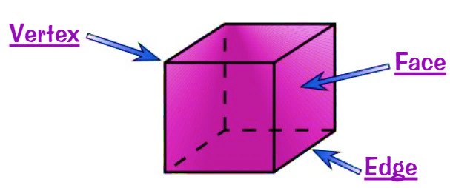
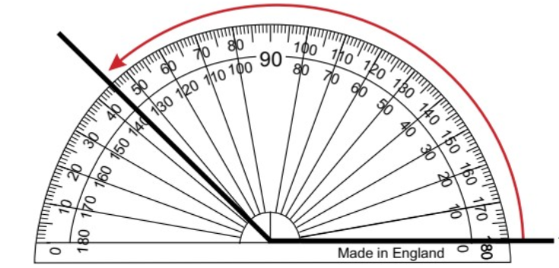
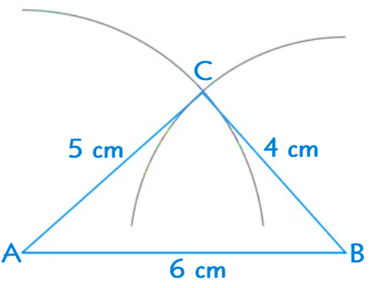
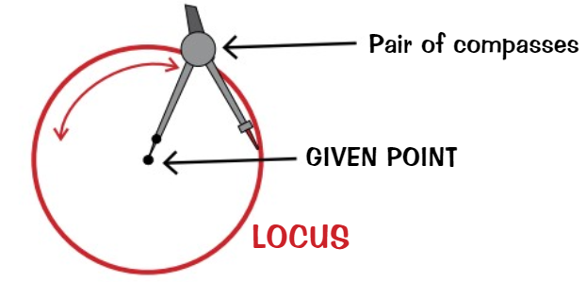
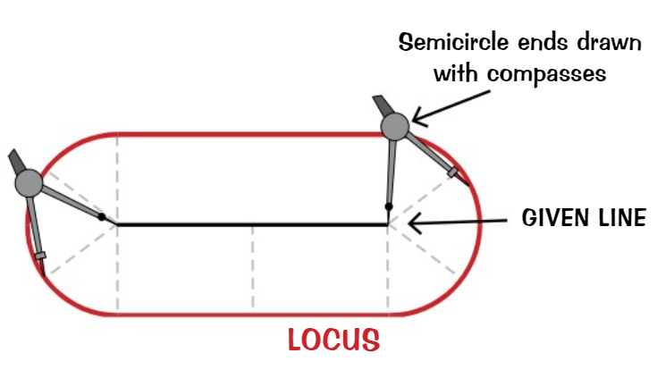
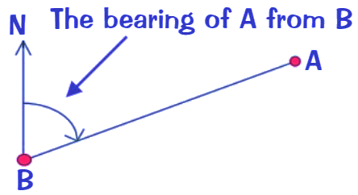
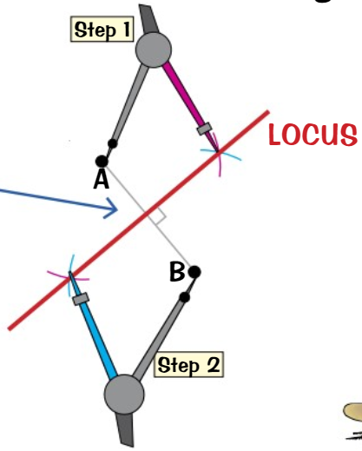
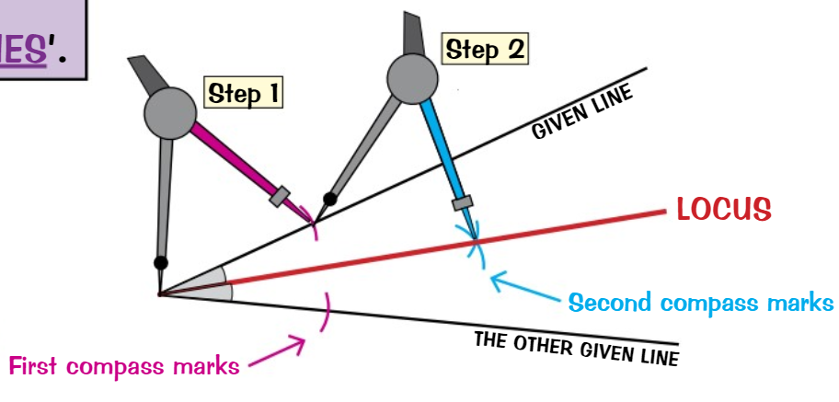
WBS Maths Knowledge Organiser
Unit 15 – constructions, loci and bearings
I can …
Recognise and describe properties of 3D shapes. | Draw 3D shapes to/from plans and elevations.
Make accurate drawings of 2D shapes. | Identify congruent triangles.
Bisect angles and lines. | Draw the loci for the path of points that follow a given rule.
Identify regions bound by loci. | Find and use three-figure bearings.
Keywords
Face, edge, vertex, vertices, prism, plane, symmetry, net, plan, elevation, isometric, compass, protractor, congruent, similar, bisect, perpendicular, bisector, equidistant, locus, loci, construct, bearing, clockwise
Properties of 3D Shapes
Remember…
Congruent Triangles
…start at zero and go round to the line.
Side, Side, Side
All 3 sides.
SSS
SAS
ASA
AAS
RHS
Right Angle, Hypotenuse, Side
Right angled triangle with Hypotenuse and another side.
Loci
Side, Angle, Side
The angle between sides.
Angle, Angle, Side
2 Angles and another side.
Angle, Side, Angle
Side between 2 angles.
Bearings
Read the question carefully
Also, leave any construction lines on.
Corbett Maths Clip
3-5, 26-7a, 68-83, 354
Hegarty maths
492-496, 660-666, 674-679. 683, 829-844
Prior Knowledge
Use of mathematical tools, names of solids, angles

