Slide 1
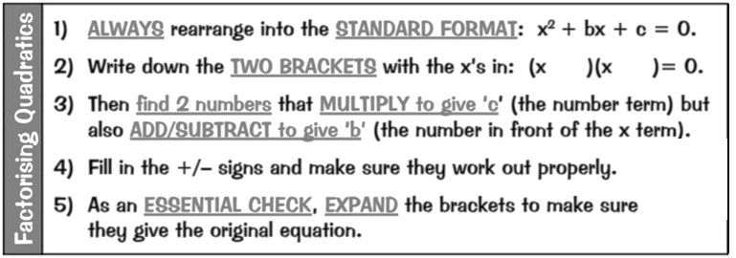
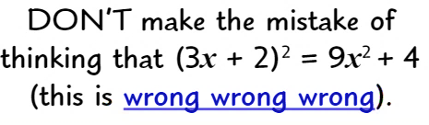
WBS Maths Knowledge Organiser
Unit 16 – quadratic equations and graphs
I can …
Multiply double brackets | Square single brackets
Plot graphs of quadratic functions | Use quadratic graphs to solve problems
Solve quadratic equations graphically | Factorise quadratic expressions
Solve quadratic functions by factorising
Keywords
Expand, difference of two squares, factorise, plot, table of values, parabola, intercept
Solving by Factorising
Expanding Double Brackets
Alternate Method
F O I L
add
$$x^{2}−x−6$$
Prior Knowledge
Linear Graphs, BIDMAS, Coordinates, Expanding Single Brackets
Corbett Maths Clip
14, 118-9, 264, 266
Hegarty maths
222-228, 251

