Slide 1
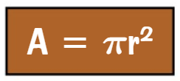
WBS Maths Knowledge Organiser
Unit 17 – Perimeter, area and volume 2
I can …
Calculate the circumference and radius of a circle. | Work out percentage error intervals.
Calculate the area and radius of a circle. | Calculate the area and perimeter of sectors.
Calculate the area and perimeter of composite shapes. | Calculate the volume and surface area of solids.
Keywords
Circumference, radius, diameter, area, sector, arc, perimeter, composite, surface area, volume
Cherry Pi Delicious
Apple Pi Are Too
All other surface area and volume formulas will be given to you in the exam.
Prior Knowledge
Areas of Squares, Rectangles and Triangles; Substitution, Calculator use
Corbett Maths Clip
40-1, 46-7, 58-62, 309-15, 355-61
Hegarty maths
534-547, 572-574, 586

