Slide 1
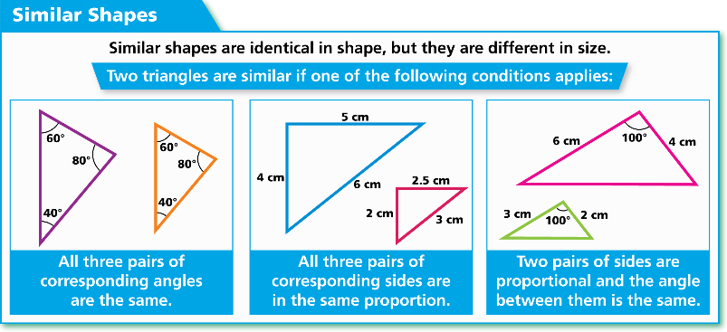
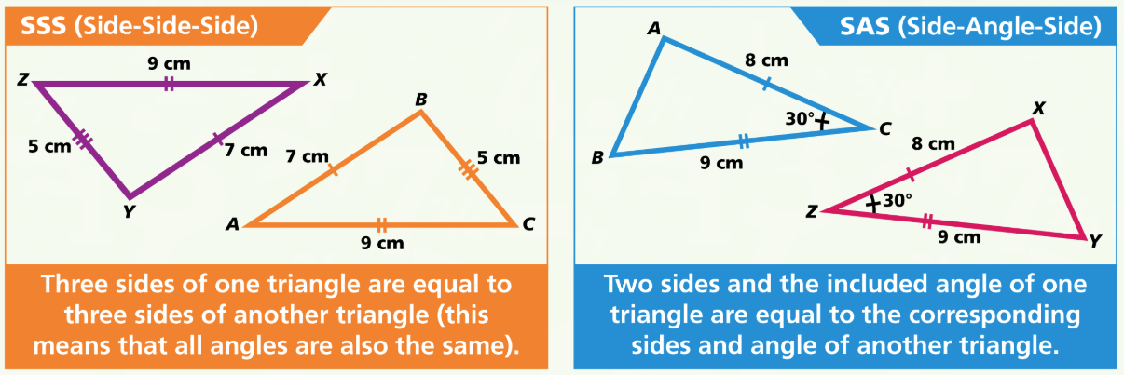
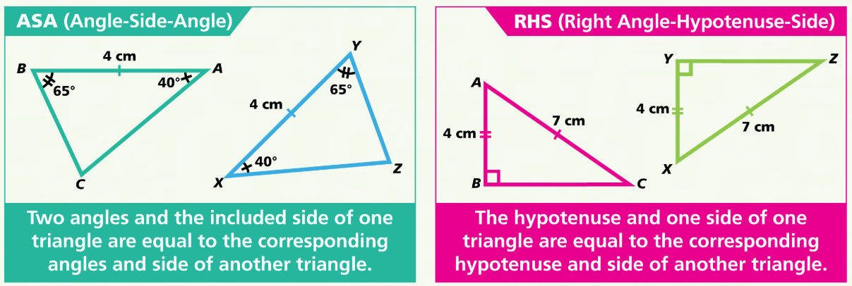
WBS Maths Knowledge Organiser
Unit 19 – congruency and similarity
I can…
Identify congruent and similar shapes.
Use congruence to work out unknown angles and sides
Find the scale factor of an enlargement.
Use similarity to solve problems.
Calculate perimeters of similar shapes.
Key Words
Congruence
Similarity
Angle
Side
Polygon
Triangle
Corresponding
Scale factor
Enlargement
Proportion
Hypotenuse
Congruent Shapes
Similar Shapes
BB
Finding a Scale Factor
Identify two corresponding sides then divide the larger by the smaller. This gives you’re the scale factor of the enlargement from the smaller shape to the larger shape.
$$\frac{6}{3}=2$$
So the s.f. = 2
Prior Knowledge
Equivalent fractions, Calculating fractions of whole numbers, Find angles using corresponding and alternate angles, Know that the sum of the angles in a triangle must be 180°.
Corbett Maths Clip
Hegarty maths
66, 67, 291, 292
611-614, 642-647, 681-690

