Slide 1

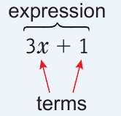
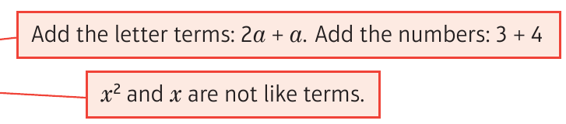

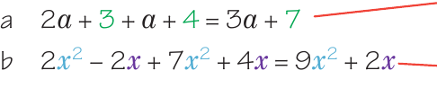
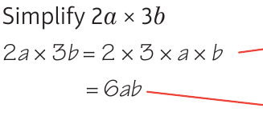
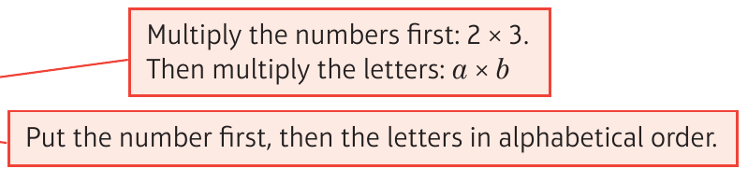


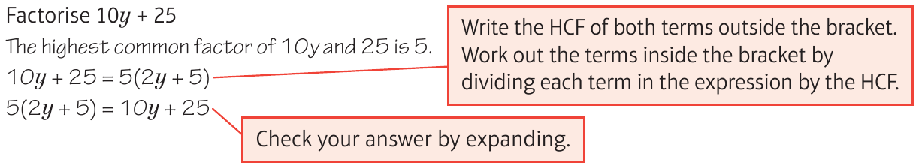

WBS Maths Knowledge Organiser
Unit 2 - algebra
I can understand and use algebraic vocabulary and notation.
I can simplify algebraic expressions.
I can write expressions and find their values.
I can expand brackets and factorise expressions completely.
I can substitute values into formulae.
Keywords
Term, Like Terms, Variable, Constant, Coefficient, Simplify, Highest Common Factor (HCF), Formula(e)
Algebraic expressions: is made up of terms
like terms can be added to simplify the expression
Substitution: replacing letters with integers
BB
S = d/t
= 200/8
= 25mph
like terms can be added to simplify the expression
Expanding brackets:
Factorising:
Prior Knowledge
Calculate with negative numbers, find HCF
Corbett Maths Clip
Hegarty maths
9, 13, 16, 18, 19, 20
151,152, 153, 160, 168, 169, 170, 171,

