Slide 1
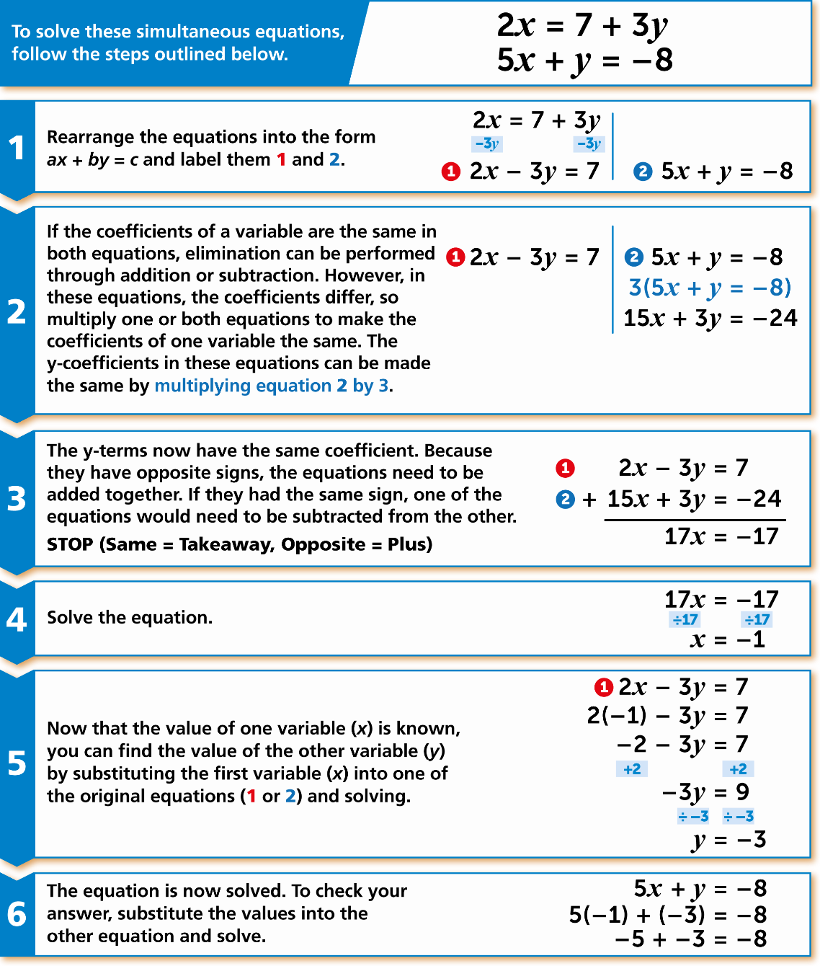
WBS Maths Knowledge Organiser
Unit 20 – simultaneous equations
I can…
Solve simultaneous equations by drawing a graph
Solve simultaneous equations algebraically
Use simultaneous equations to represent word problems in algebra
Key Words
Simultaneous
Equation
Coefficient
Intersection
Solving graphically
Solving algebraically
BB
Prior Knowledge
Write algebraic expressions, Add and subtract positive and negative terms,
substitute integer and decimal values into a simple expression.
Corbett Maths Clip
295, 296, 297
Hegarty maths
190-195, 218, 219

