Slide 1
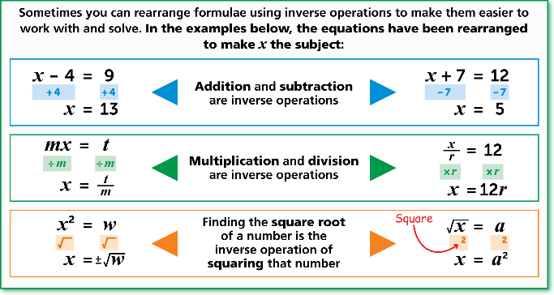
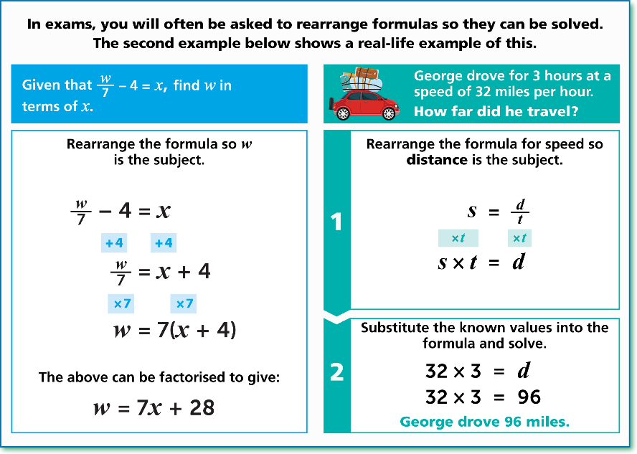
WBS Maths Knowledge Organiser
Unit 20b – cubic and reciprocal graphs and rearranging formulae
I can…
Sketching and identifying cubic graphs
Sketching and identifying reciprocal graphs
Draw and interpret non linear graphs to solve problems
Understand the inverse of operations
Change the subject of formulas
Key Words
Inverse
Formula
Operation
Variable
Cubic
Reciprocal
BB
Rearranging Formulas
Recognising Graphs
Prior Knowledge
Identify inverse operations for algebraic terms, Identify parallel lines from the equations of the lines, Recognise the shape of linear and quadratic graphs, Find reciprocals of fractions and integers.
Corbett Maths Clip
Hegarty maths
7, 8, 344, 345, 346
280-286, 298-301, 894, 895

