Slide 1
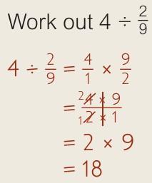
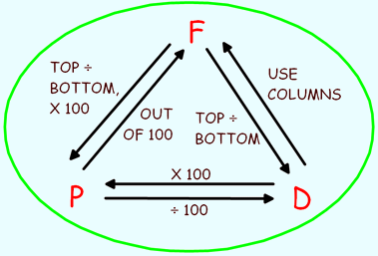

WBS Maths Knowledge Organiser
Unit 4 - Fractons, decimals and percentages
I can add and subtract fractions, including mixed numbers.
I can multiply and divide fractions, including mixed numbers.
I can convert fractions to decimals to percentages….
I can order fractions decimals and percentages.
I can find fractions of amount.
Keywords
Denominator, Numerator, Unit Fraction, Reciprocal, Mixed Number, Improper Fraction
Add and subtract fractions
BB
Multiply and divide fractions
$$\frac{1}{2}x\frac{5}{6}$$
=
=
Converting Fractions – decimals - percentages
Ordering FDP
Fraction of amount
Divide by the denominator
$$18 ÷9 =2$$
Multiply by the numerator
$$2 ×4 =4$$
Convert all to decimals first
0.375, 0.357, 0.335, 0.35
=
Prior Knowledge
Place value, division, numerator, denominator, equivalent fractions, fraction of amount, LCM, convert between mixed numbers and improper fractions.
Corbett Maths Clip
Hegarty maths
121, 122, 123, 124, 125, 126, 127, 128, 131, 133, 134, 137, 142
59 - 67

