Slide 1

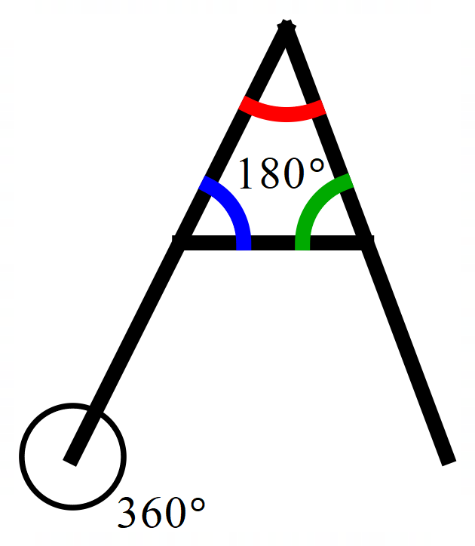
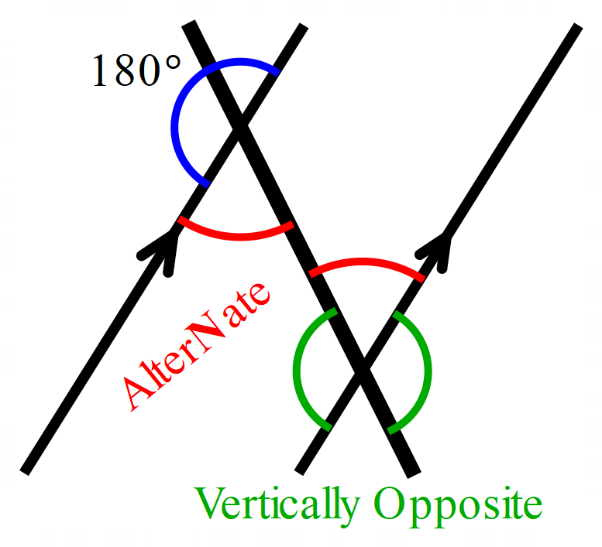
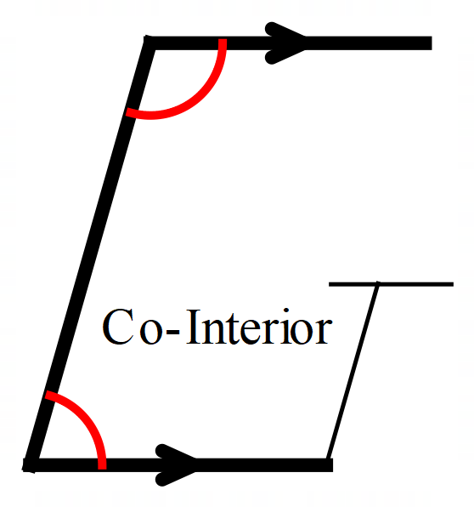
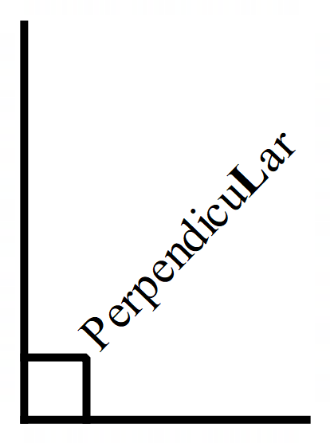
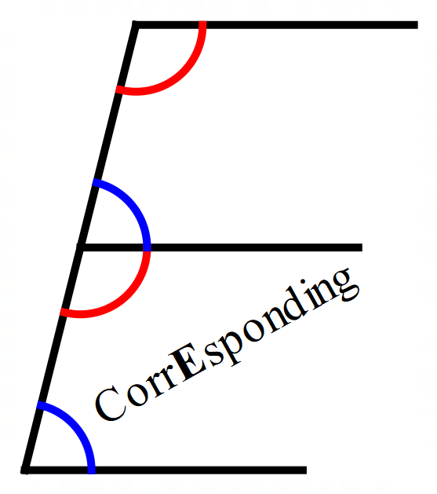
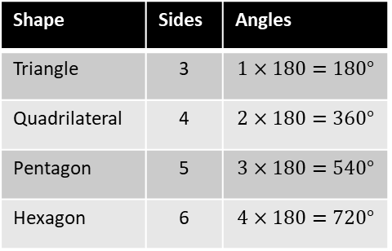


WBS Maths Knowledge Organiser
Unit 6 - angle rules
I can …
Solve problems using quadrilateral properties. | Identify congruent shapes.
Calculate missing angles on parallel lines. | Solve angle problems in triangles.
Calculate interior and exterior angles of polygons. | Explain why some shapes tessellate.
Solve angle problems using equations.
Keywords
Congruent, Similar, Bisect, Diagonal, Vertex, Vertices, Edge, Face, Opposite, Parallel, Perpendicular, Alternate, Corresponding, Co-Interior, Equilateral, Isosceles, Scalene, Interior, Exterior, Sum, Regular, Polygon, Irregular, Tessellate.
Angle Facts
Congruent – (Identical)
A shape is congruent if they are identical.
Triangle have rules for checking for congruency.
Side, Side, Side
All 3 sides.
SSS
SAS
ASA
AAS
RHS
Right Angle, Hypotenuse, Side
Right angled triangle with Hypotenuse and another side.
Side, Angle, Side
The angle between sides.
BB
Interior Angles
Exterior Angles
(Number of sides – 2)$×180°$
Exterior = 180 – Interior
Angle, Angle, Side
2 Angles and another side.
Angle, Side, Angle
Side between 2 angles.
Tessellation
Where shapes fit together without a gap.
Exterior
Regular Exterior Angle
Interior
360º
Number of sides
$\frac{360}{interior}$ has to be an integer for the shape to tessellate.
Prior Knowledge
Basic Angle Facts, Properties of 2d shapes
Corbett Maths Clip
2, 66, 67, 25, 36, 32, 36
Hegarty maths
477, 478, 560-562, 812-815

