Slide 1
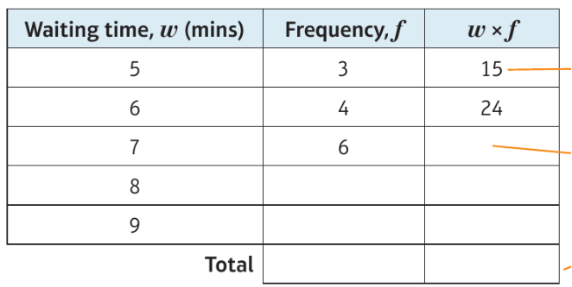
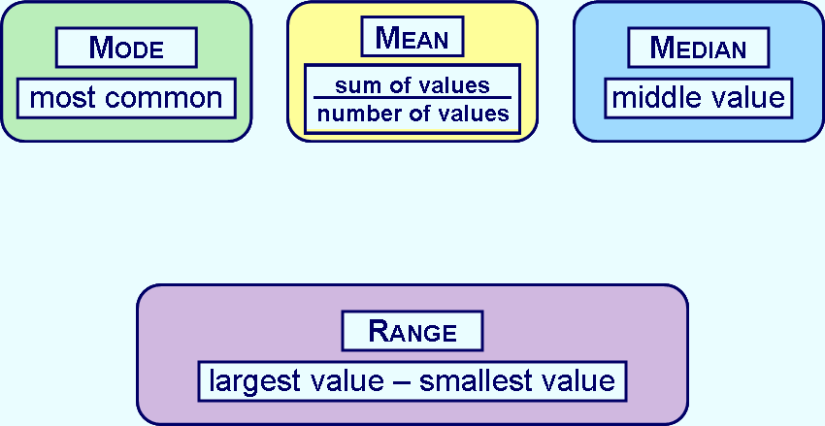
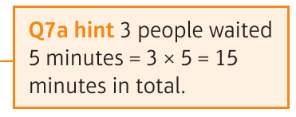
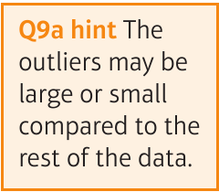
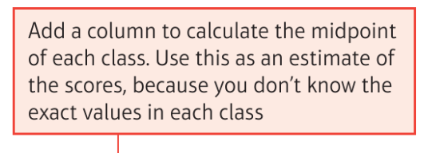
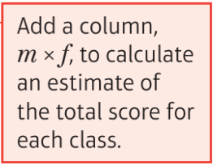
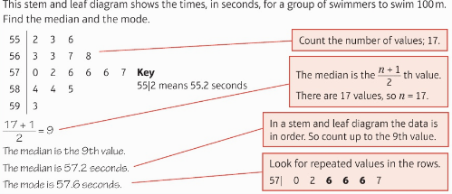
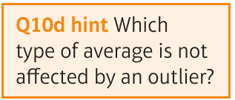
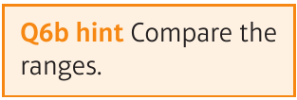
WBS Maths Knowledge Organiser
Unit 7 – averages and range
I can
Keywords
Mode, median, mean, range, outliers, frequency, modal class, grouped data, estimate, sample, population, bias, random sample
calculate mean, mode, median and range | compare two sets of data using an average and the range.
…. from a frequency table and stem and leaf diagram. | select the most appropriate average to represent a set of data.
…. grouped data and identify the class containing the | median and the modal class.
Averages and range
Estimated and range from a frequency table
BB
12, 10, 7, 8, 13, 10
Ordered
7, 8, 10, 10, 12, 13
$$Est mean=\frac{140}{20}=7$$
Mode = 10
Mean =$\frac{60}{6}$ = 10
Median =$\frac{10+10}{2}=10$
Range = 13-7 = 6
Put in numerical order
$$Range =$$
$$smallest waiting time−largest waiting time$$
20 140
$$range=9−5=7$$
Estimate averages from grouped
Frequency
The mean, the median and the mode all have their strengths and weaknesses.
Median - $\frac{total f+1}{2}= \frac{31}{2}=15.5$ is 11-15
Modal class - most populated = 16-20
Prior Knowledge
Mode, median, mean range, frequency tables, tallying, stem and leaf, charts and diagrams
Corbett Maths Clip
Hegarty maths
50, 51, 52, 53, 54, 55, 56, 57
404 - 418

