Slide 1
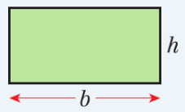
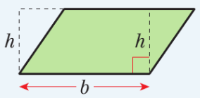
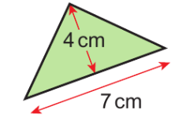
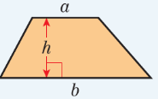
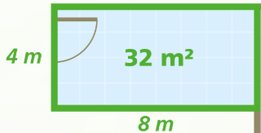
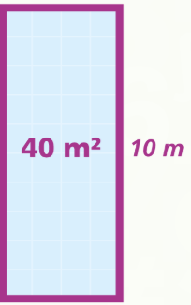
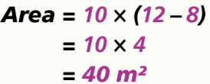
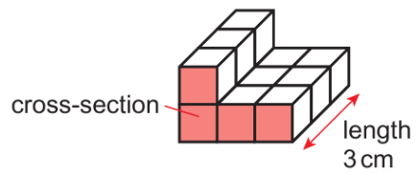
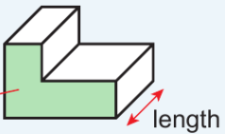
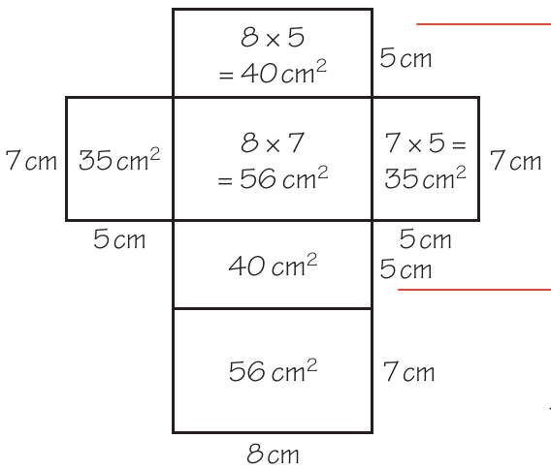
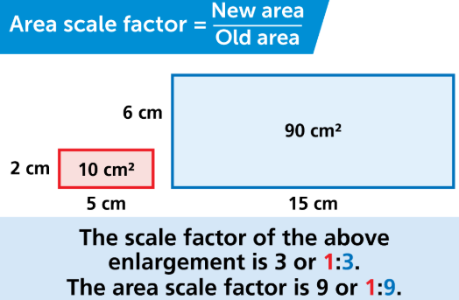
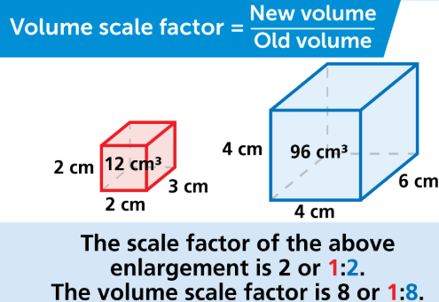
WBS Maths Knowledge Organiser
Unit 8 – perimeter, area and volume
I can find the perimeter and area of rectangles, triangles, parallelograms and trapeziums.
I can find the area of compound shapes made from rectangles and triangles.
I can find the surface area and volume of 3D solids.
I can convert between metric units of area volume and capacity.
I can work backwards to find a missing length.
Keywords
Perimeter, area, perpendicular height, trapezium, isosceles, compound shape, surface area, volume, capacity
Averages and range
Estimated and range from a frequency table
Perimeter is the distance around the outside of a shape. Area measures the space inside a 2D shape. Volume measures the amount of space inside a 3D shape
Area
BB
Area of a rectangle
Surface Area and Volume
Converting between units
Count the cubes = 12cm2
Prior Knowledge
Perimeter, area, units of length, area and volume, 2D shapes and 3D shapes
Corbett Maths Clip
Hegarty maths
41,44,45,48,49,309,310,355,356
548-559, 567, 582, 836

