Slide 1
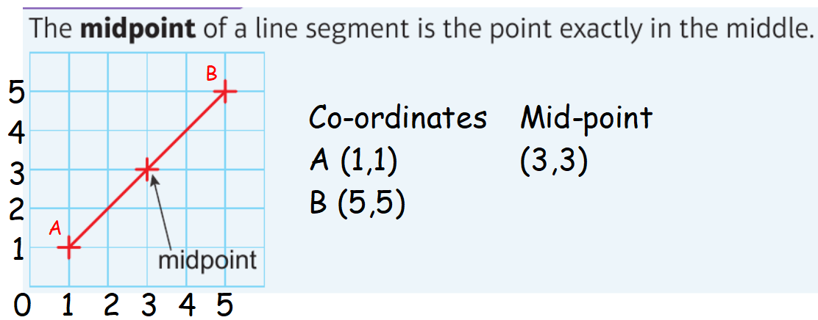
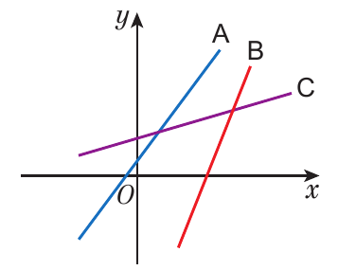
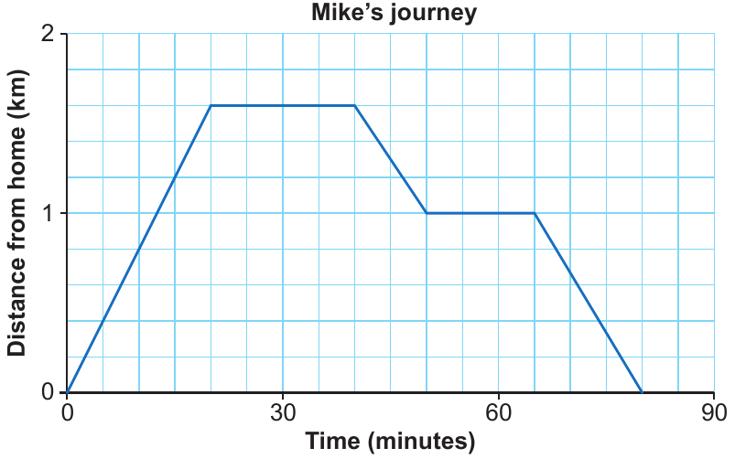
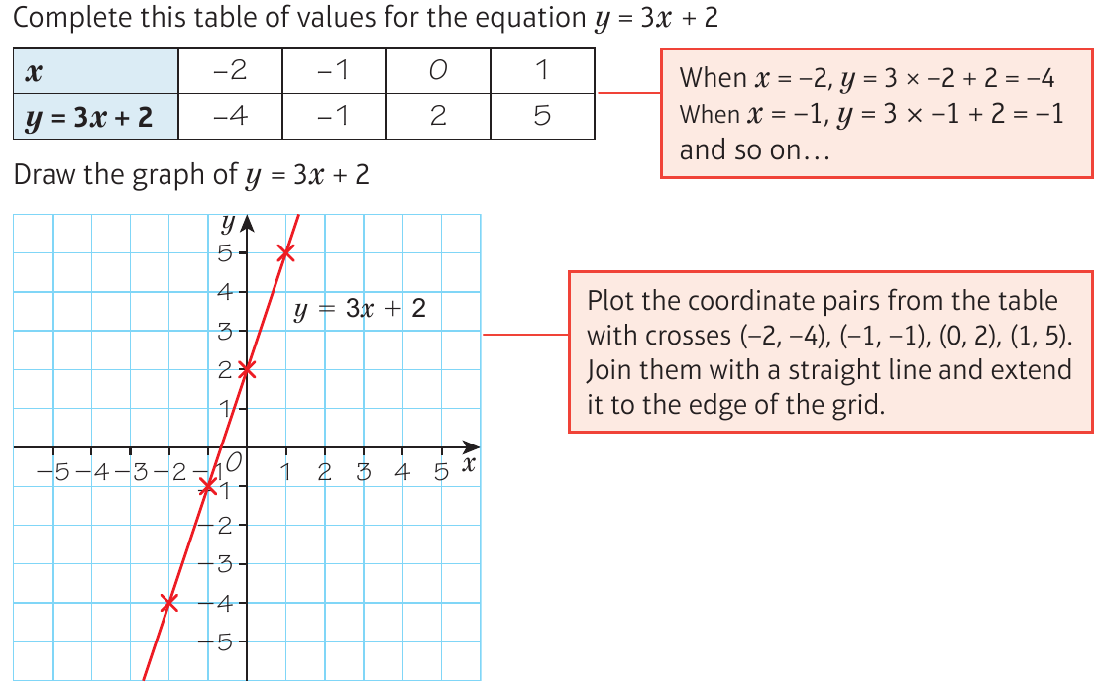
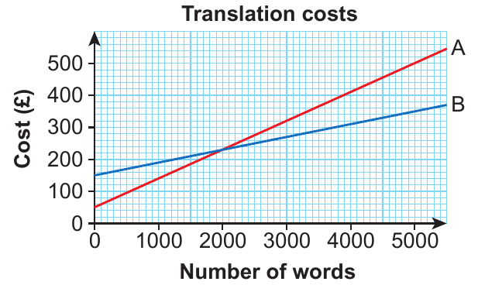
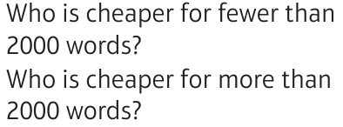
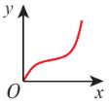
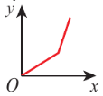
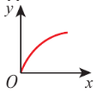
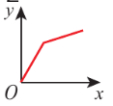
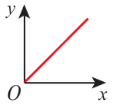
WBS Maths Knowledge Organiser
Unit 9 - graphs
I can plot and read co-ordinates.
I understand linear graphs – y=mx+c
I can find and use the gradient of a graph.
I can interpret real-life graphs.
I can interpret distance-time graphs.
Keywords
Parallel, midpoint, line segment, Gradient, coefficient, distance–time graph, average speed,
velocity–time graph, velocity, constant rate
Averages and range
Estimated and range from a frequency table
Line segment and coordinates
Gradient
Time-distance graphs
BB
BB
Not moving
Linear graphs – y = mx + c
Gradient =
Speed = $\frac{dist}{time}=\frac{1.6}{0.3}=4.8kph$
Real life graphs
B
A
m = gradient
c = y-intercept
Prior Knowledge
Function machines, co-ordinates, parallel lines have same gradient, m= gradient distance/speed/time relationship, interpret graphs.
Corbett Maths Clip
Hegarty maths
84 171 185 186 187 188 189 190 191 194 196 197 198
206-214, 874-879, 894, 895

