Slide 1

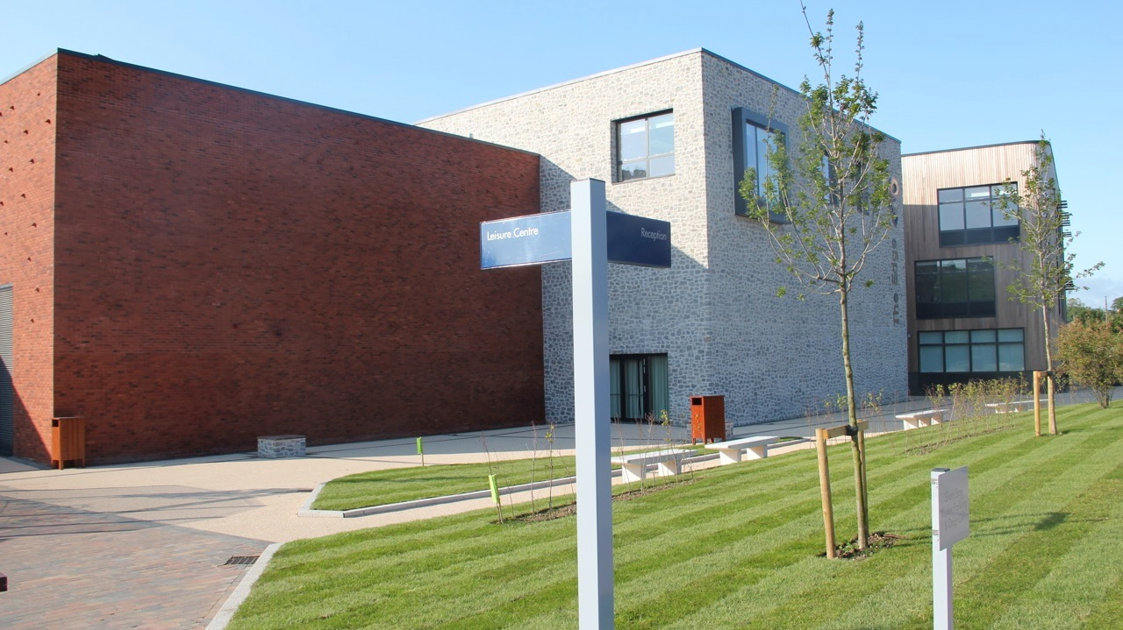
Changes to KS4 Curriculum 2025
The new school vision is ‘Healthy Body, Healthy Mind’
Our school values are ‘Respect. Excellence. Friendship’
Inspired by the Olympic values

Slide 2
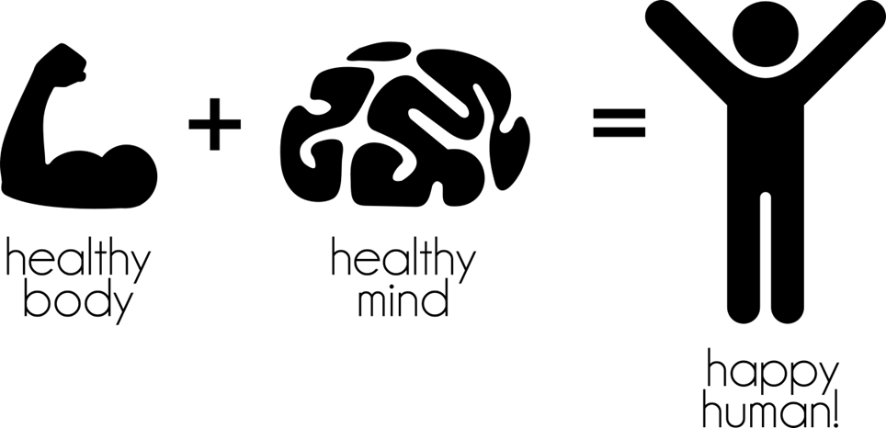
Changes to KS4 Curriculum 2025
‘Healthy Body, Healthy Mind’
Why is this the right vision for WBS?
Olympic heritage that should be our unique selling point (USP)
Only Coubertin School in the UK
Outstanding sporting facilities (that the Headteacher is fighting hard to save, maintain and improve for the school and community)

Slide 3


Changes to KS4 Curriculum 2025
Mental Health crisis in young people
Globally, one in seven 10-19-year-olds experiences a mental disorder
Depression, anxiety and behavioural disorders are among the leading causes of illness and disability among adolescents
The consequences of failing to address adolescent mental health conditions extend to adulthood, impairing both physical and mental health and limiting opportunities to lead fulfilling lives as adults
8 to 11% of children and adolescents suffer from anxiety that affects their ability to get on with their lives.

Slide 4
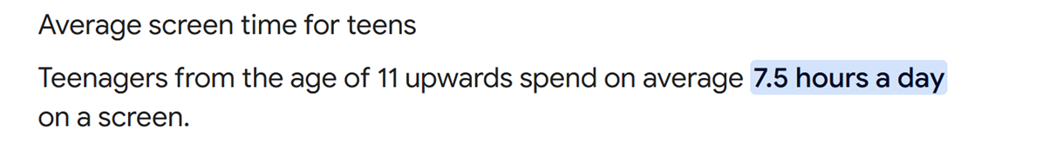

Changes to KS4 Curriculum 2025
Extended screen time has become increasingly normal for young children and teenagers
Research suggests a 52% increase in children’s screen time between 2020 and 2022, and that nearly 25% of children and young people use their smartphones in a way that is consistent with a behavioural addiction
Screen use has been found to start as early as six months of age. One in five children aged between three and four years old have their own mobile phone
Children in care, care leavers, young carers, children experiencing poverty and children with additional needs are more susceptible to online harms

Slide 5


Changes to KS4 Curriculum 2025
Physical activity guidelines for children and young people
How much physical activity should children and young people aged 5 to 18 do to keep healthy?
Children and young people need to do 2 types of physical activity each week:
Aerobic exercise
Exercises to strengthen their muscles and bones
Children and young people aged 5 to 18 should:
Aim for an average of at lest 60 minutes of moderate of vigorous intensity physical activity a day across a week
Take part in a variety of types and intensities of physical activity across the week to develop movement skills, muscles and bones
Reduce the time spent sitting or lying down and break up long periods of not moving with some activity. Aim to spread activity throughout the day
Only about 1 in 4 high school students get the recommended hour a day of physical activity, according to statistics from American Heart Association. Screen time is partially to blame, along with declining physical education programs in school, experts say. Teens are missing out on the health benefits, which range from a stronger heart to better mental health

Slide 6

Changes to KS4 Curriculum 2025
Health Survey for England 2022
Key Findings
Among children aged 2 to 15, the prevalence of obesity was 15%, the prevalence of overweight (including obesity) was 27%
21% of children aged 8-15 were trying to lose weight, while 5% were trying to gain weight

Slide 7


Changes to KS4 Curriculum 2025
Outside play
Just 27% of children say they regularly play outside their homes, compared to 71% of the baby boomer generation
One in four children who took part in the survey said they had been told to stop playing in the street of local area either by their parents or neighbours and 30 percent said they had been told to stop making a noise outside
According to a 2016 survey, 75% of children in the UK are getting less time outside than prison inmates

Slide 8
Changes to KS4 Curriculum 2025
Outside play
Helen Dodd, Professor of Child Psychology at University of Exeter, said: “It’s really striking to see this gradual decline in playing out over time. This […] represents a huge change to the nature of childhood experiences. It’s logical to expect this to have consequences for young people’s development. As a society we’re perhaps not taking seriously enough. Some consequences of this reduced level of playing out could be on friendship development, social skills, freedom, independence and negotiation of shared spaces. We are also concerned that these changes to children’s experiences could have an adverse effect on their mental health”
In Balanced and Barefoot: How Unrestricted Outdoor Play Makes for String, Confident and Capable Children, Angela J. Hanscom writes “kids of all ages should get at least three hours of free play outdoors a day”

Slide 9
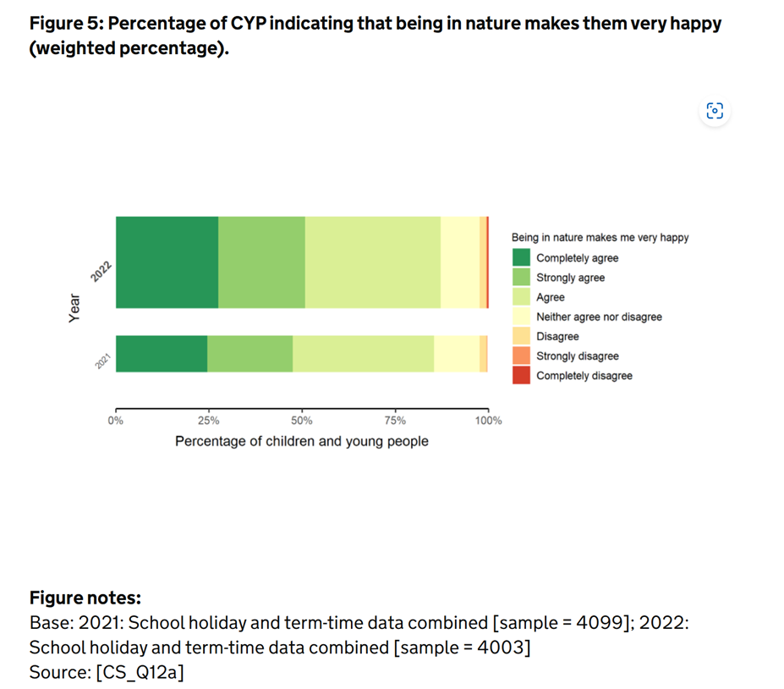

Changes to KS4 Curriculum 2025
The Children’s People and Nature survey for England, 2022

Slide 10

Changes to KS4 Curriculum 2025
How can increased physical activity and being outdoors help mental health?
Being active releases chemicals in your brain that make you feel good – boosting your self-esteem and helping you concentrate as well as sleep and feel better.
Other benefits:
Less tension, stress and mental fatigue
Sense of purpose
Gain confidence
A natural energy boost
A sense of achievement
More focus and motivation
Feeling less angry or frustrated
A healthy appetite
Having fun
It’s even better if you’re able to get active outdoors. Research shows that being in nature can make us feel happier, feel our lives are more worthwhile and reduce our levels of depression and anxiety.

Slide 11

Changes to KS4 Curriculum 2025
How can increased physical activity help learning?
Increasing physical activity and physical fitness may improve academic
performance
Available evidence suggests that mathematics and reading are the academic
topics that are most influenced by physical activity
Executive function and brain health underlie academic performance. Basic
cognitive functions related to attention and memory facilitate learning, and
these functions are enhanced by physical activity
Single sessions of and long-term participation in physical activity improve
cognitive performance and brain health. Children who participate in
vigorous or moderate-intensity physical activity benefit the most
Students should be provided with frequent physical activity breaks
Although presently understudied, physically active lessons offered in the
classroom may increase time on task and attention

Slide 12

Changes to KS4 Curriculum 2025
What can we do at WBS?
Improve our children’s mental and physical health by increasing the amount
of physical activity within the curriculum
Change the school culture so that participating in regular physical activity
and being outside is the norm
Promote the school within the community as the school a parent can send
their child to and their physical and mental health will be taken seriously.
Where they will have regular time outdoors
Widen the variety of sports and activities available to students in and
outside of the classroom. Increase student choice
Illustrate our alignment with healthy living via the school uniform so that
students are always dressed appropriately for physical activity, adventure
and the outdoors
Change the structure of the school day to facilitate greater levels of activity

Slide 13
Changes to KS4 Curriculum 2025
Considerations and limitations considered during KS4 curriculum design process
Very poor GCSE outcomes across the ability range. The curriculum model is not working for our children
The current model does not promote inclusivity and does not allow all children to flourish or meet their potential
Science have been unable to deliver the Double Science curriculum adequately following the reduction in KS4 Science teaching hours (2023) from 12 to 10 hours
Science were given 10 (2022/23) hours of teaching time a fortnight which meant imbalanced teaching of Biology, Chemistry and Physics, leading to an unacceptably inconsistent experience for students – forecasted results in Year 11 reflect this
Parents of higher ability students voice their dissatisfaction of the lack of stretch and challenge for their children
Year 9 have had a particularly disrupted KS3 Science experience due to Science staff shortages and high staff absences in Science 2022/23/24
We have no vocational provision for non EHCP children 2023/24 due to budgetary constrictions – the current Y10 have experienced higher levels of behavioural incidents and higher levels of student disengagement, especially in middle and lower ability boys, partly due to an inappropriate curriculum offer
Students don’t all want to study 9 GCSEs. The previous model had no provision for any other offer unless a child has an EHCP which might provide funding for 1:1 supervision during teaching time. Routine child and parental frustration that their child couldn’t study fewer GCSEs or drop one part way through the course
Large numbers of middle and lower ability students not securing their English and Maths Grade 4 which directly impacts their post 16 options and life choices
The school has historically offered a high level of GCSEs, but outcomes don’t suggest this is the right model for our children
The current curriculum model does not make a feature of physical fitness and offers no level of choice to students in terms of what sports/ activities they would like to participate in
The current curriculum model does not allow time for students to spend extend periods outside, hillwalking, cycling etc

Slide 14
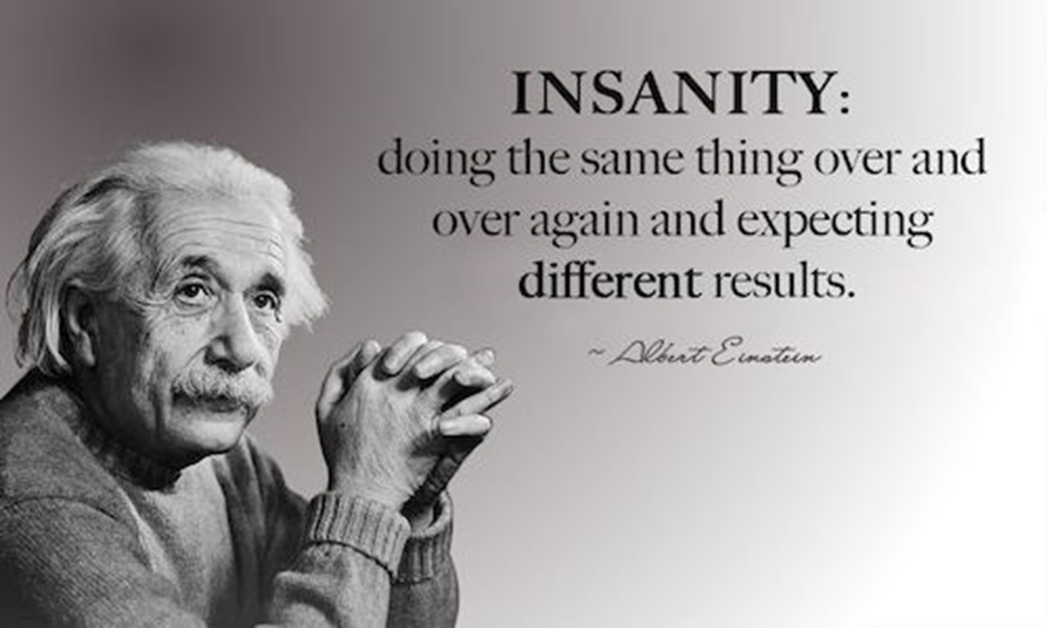
Changes to KS4 Curriculum 2025

Slide 15
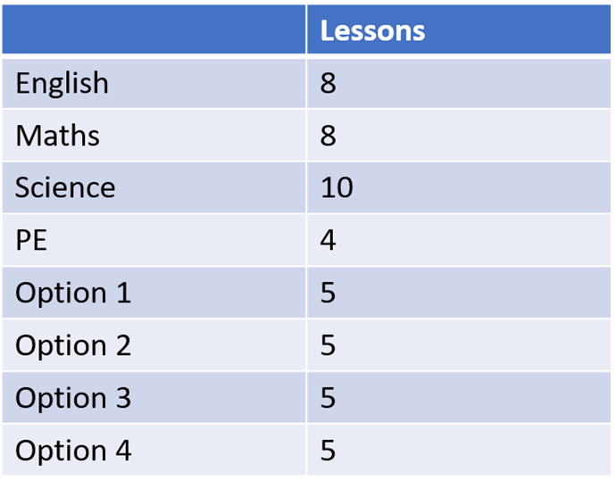
Changes to KS4 Curriculum 2025
KS4 Before
Pros
Students can take a large number of GCSEs, including 4 GCSE options of their choice – this might or might not include Triple Science
Cons
‘One size fits all’
Enjoyed by a small number of academic students - was not bespoke to ability or need
Poor outcomes for students of all abilities, including our brightest
Impossibly high Alternative Provision costs for EHCP students
No Alternative Provision for those without an EHCP
Insufficient/ imbalanced Science teaching time
Large numbers of students who found 9 GCSEs too much to start with or wanted to drop a GCSE part way through the course which is financially impossible, even when the teacher and safeguarding team can see that it’s the kindest option for the child
Promotes the study of 9 GCSEs when this is an unnecessarily high number of GCSEs (you can get into Oxford/ Cambridge with 8/ The Government measures schools on 8)
Doesn’t allow for Enrichment opportunities outside of school

Slide 16
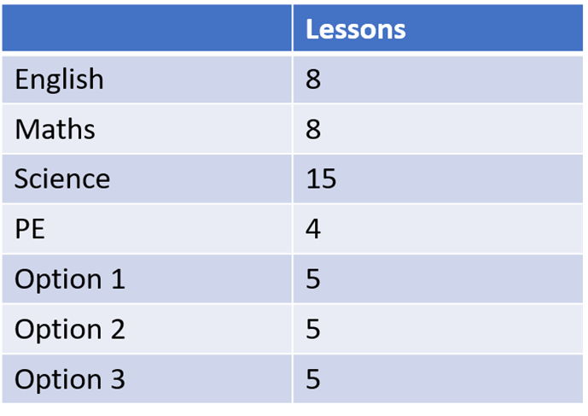
Changes to KS4 Curriculum 2025
KS4 After: Academic
Pros
Addresses frequent concerns raised by the parents of more academically able children that their children aren’t pushed enough
Allows a more academic group of students to study Science (and those that are not as strong at Science to have significant catch up in a nurturing env.)
Makes clear to students they should be aiming high
No restrictions on what students choose as their 3 remaining options (students could choose 3 Arts subjects if they wish)
OFSTD’s 2015 report on support for the most able, said many schools don’t encourage enough students to apply for ‘top’ universities
NACE: ‘What do most children want? Harder work’ Increase the challenge for most able children.
‘The attainment gap is particularly big for girls. Bright but poor girls lag 3 yrs behind bright but better off girls in Science’ Centre for analysis of Youth Transitions, 2014
Cons
Students who want 2, not 3 qualifications in Science could be put off the Academic Route
Reduces free choice of GCSE options from 4 to 3 (if a students wouldn’t have chosen Triple Science

Slide 17
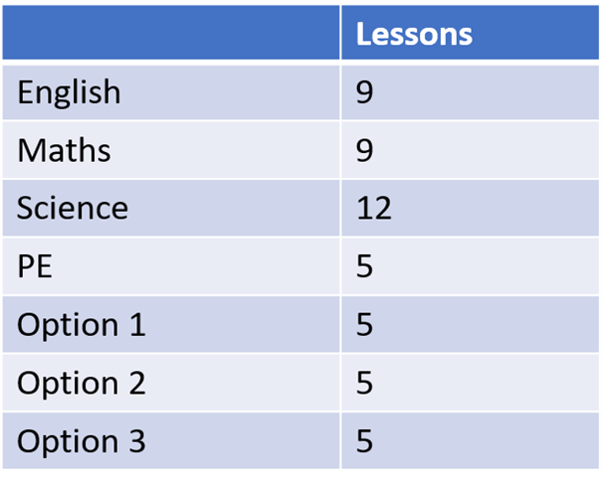
Changes to KS4 Curriculum 2025
KS4 After: Enrichment
Pros
Many WBS students will get better outcomes when focusing on 8, rather than 9 GCSEs
8 GCSEs is a solid amount of GCSEs to follow, opening every door post 16 and 18
Students will benefit from additional Maths and English time to boost their Maths and English grades and confidence
Students will have a balanced diet of Science and adequate time to cover the course
Students will benefit from additional time in PE where they will have an option based system and can choose out-of-school physical enrichment, or a greater variety of in-school options
Cons
Students can’t choose Triple science, however students can still get into medicine with Double Science, and into Cambridge/ Oxford with 8 GCSEs

Slide 18
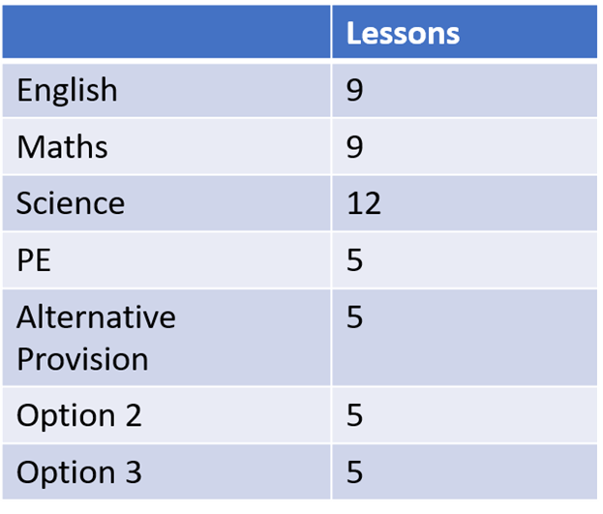
Changes to KS4 Curriculum 2025
KS4 After: Vocational
Pros
A growing number of our students cannot access 9 GCSEs and can now access 7 with a full curriculum offer in place
This route makes a strong statement about our commitment to delivering our own Alternative Provision
More economically sound model for the school that avoids over-priced AP and uses existing staff who no longer teacher VI form (avoids redundancy)
Puts our vulnerable children at the forefront of curriculum design
Allows academic success for all
Cons
?

Slide 19
Changes to KS4 Curriculum 2025
Parental concerns
The only concerns raised with me have been around students who are academically able but would have preferred to choose 4 GCSE options that did not include Triple Science.
School response:
Unfortunately, it is forecasted that many of our Arts subjects, namely Music and Dance are unlikely to run this year due to lack of popularity with students (not enough numbers)
Curriculum models do change. Up to two years ago, all students had to take a Language at GCSE
Some Y9 students have been ‘put off’ Science due to high levels of staff absence and a national shortage of Science graduates who want to be teachers (this issue is now resolved)
In 2023, it was agreed that Science teaching hours at KS4 be dropped by 2 hours, this has meant the teaching of Science has been problematic and this has been reflected in KS4 GCSE data for Y10 and 11 -the model hasn’t worked. In order to give Science back their two hours, so they can deliver the course, this means that we can no longer offer 9 GCSEs to include Double Science – there is simply not the curriculum time
Bright girls, especially those from lower income families, are a target group for raising attainment and engagement in Science. Historically, research shows that these subgroups are more reluctant to pursue a study of Science
Over the years I have been at WBS, many families have raised concerns that their bright children have not been pushed enough – the Academic Route offers an opportunity for our most able children to put themselves outside of their comfort zones, something many are not used to
The Triple Science group will be, in old fashioned terms, a top set – the environment will be nurturing and aspirational, and will take into account the gaps in learning from KS3
We will be running Summer top up Science classes for students who have chosen the Academic Route but lack confidence or enjoyment in Science to give them a boost
The additional teaching time in Science will be used to promote a love of Science by including a more practical element
Students who take 8 GCSEs can still get into Russell universities. Students who take Double Science can still study Medicine at University if their grades are good enough

